Slide 1

COMPUTER NETWORKS M23DE0203
UNIT-II
School of CSA/ MCA- 2nd Semester
Prof.Nagaraj C

Slide 2
UNIT II

Slide 3
COMPUTER NETWORKS UNIT-II: The Data Link Layer
School of CSA,BCA
Prof. Nagaraj C

Slide 4
CONTENTS:
Data link layer design issues
Error Detection and Correction
Sliding window protocol
Example Data link protocols.
MAC sub layer: channel allocation problem
Multiple Access Protocols
Ethernet
Wireless LANs
data link layer switching

Slide 5
LECTURE 1:
AGENDA
Introduction
Data link layer design issues
Quiz

Slide 6
INTRODUCTION :
Different networks are used to transfer data from one device to another with acceptable accuracy.
For most applications, a system must guarantee that the data received are identical to the data transmitted.
Transmission media are most error-prone link
In a network, the capacity of nodes is different
The rate at which the sender is sending data might not be the same rate at which the receiver accepts it.

Slide 7
Data Link Layer is the second layer of OSI Layered Model.
Data link layer is responsible for converting data stream to signals bit by bit and to send that over the underlying hardware.
At the receiving end, Data link layer picks up data from hardware which are in the form of electrical signals assembles them in a recognizable frame format, and hands over to upper layer

Slide 8
Data link layer has two sub-layers:
Logical Link Control : Manages communication between the network layer and the MAC sublayer.
Flow Control: Ensures data isn't sent too quickly for the receiver.
Error Control: Detects and corrects errors from the physical layer.
Protocol Multiplexing: Allows multiple network layer protocols (like IP- Delivers packets across networks using logical IP addresses, ICMP(Internet Control Message Protocol)- Sends error messages and operational info)) to share the same data link.
Logical addressing: Adds headers to identify which network layer protocol to pass data to.
Media Access Control : Controls how devices on a network gain access to the medium and permission to transmit data.
Physical Addressing: Uses MAC addresses to identify devices on the network.
Media Access Control: Manages how and when a device can transmit data (avoiding collisions).
Frame Delimiting and Error Detection: Adds preamble(starting of the frame) and CRC(end of the frame) to frames.
Channel access policies: Like CSMA/CD (Ethernet), CSMA/CA (Wi-Fi).

Slide 9
The main functionalities/Design issues of Data link layer are:
Framing
Addressing
Synchronization
Error Control
Flow Control
Multi-Access

Slide 10
1) Framing
Break down a stream of bits into smaller, digestible chunks called frames
Allows the physical media to be shared
Multiple senders and/or receivers can time multiplex the link –
Each frame can be separately addressed
Helps identify the beginning and end of a message so that the receiver can interpret the data correctly.
Example: Ethernet frames, which contain header and trailer information.

Slide 11
2. Addressing
Identifying the source and destination devices at the data link layer.
Purpose: Ensures that data is sent to the correct physical device using MAC (Media Access Control) addresses.
Example: A switch uses MAC addresses to forward data to the correct port.

Slide 12
3. Synchronization
Definition: Ensuring that the sender and receiver are synchronized in terms of data transmission timing.
Purpose: Maintains data integrity by aligning the sender's and receiver's clocks or signals.
Example: Bit stuffing or preamble bits in Ethernet for synchronization.

Slide 13
4. Error Control
Detecting and possibly correcting errors that occur in the physical transmission of data.
Purpose: Guarantees data integrity and reliability.
Techniques:
Parity bits
CRC (Cyclic Redundancy Check)
ACK/NACK protocols

Slide 14
5. Flow Control
Managing the rate of data transmission between sender and receiver to prevent buffer overflow.
Purpose: Ensures that a fast sender does not overwhelm a slower receiver.
Example: Sliding Window Protocol.

Slide 15
6. Multi-Access (or Medium Access Control)
Controls how multiple devices share a common transmission medium.
Purpose: Prevents data collisions in shared media networks.
Techniques:
CSMA/CD (Carrier Sense Multiple Access with Collision Detection) – used in Ethernet
CSMA/CA (Collision Avoidance) – used in Wi-Fi

Slide 16
QUIZ 1:
1) The data link layer takes the packets from _________ and encapsulates them into frames for transmission. a) network layer b) physical layer c) transport layer d) application layer Answer: a
2) Header of a frame generally contains ______________ a) synchronization bytes b) addresses c) frame identifier d) all of the mentioned Answer: d

Slide 17
SUMMARY:
Introduction
Data link layer design issues
Quiz

Slide 18
LECTURE 2:
RECAP
Introduction
Data link layer design issues
Quiz
AGENDA
Error Detection and Correction
Quiz

Slide 19
Error Detection and Correction :
An error is the change or the mismatching take place between the data unit sent by transmitter and the data unit received by the receiver.
Example: 10101010 sent by sender 10101011 received by receiver.
Here is an error of 1 bit.
Types of Errors:
1. Single bit error
2. Multiple bit error
3. Burst error

Slide 20
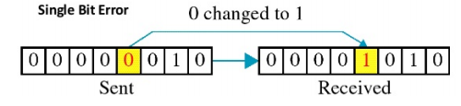
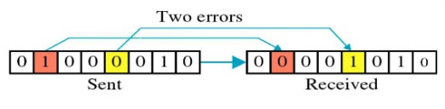
Types of Errors:
1) Single bit error: In a single-bit error, only 1 bit in the data unit has changed.
2) Multiple Bit Error: More than one nonconsecutive bits change from 0 to 1 or 1 to 0

Slide 21
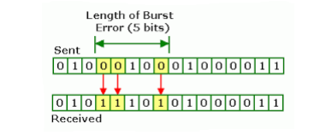
Types of Errors:
3) Burst error: A burst error means a group of consecutive bits are altered.

Slide 22
Error Control:
It refers to mechanisms to detect and correct errors that occur in the transmission of frames.
Error detection uses the concept of redundancy, which means adding extra bits for detecting errors at the destination.
There are 4 types of redundancy checks are common in data communication:
Parity check
Two dimensional parity check
Checksum.
Cyclic Redundancy check (CRC)

Slide 23
QUIZ 2:
When 2 or more bits in a data unit has been changed during the transmission, the error is called ____________
a) random error b) burst error c) inverted error d) double error Answer: b
2) Which of the following is a data link protocol? a) ethernet b) point to point protocol c) hdlc d) all of the mentioned Answer: d

Slide 24
SUMMARY:
Data link layer design issues
Error Detection and Correction
Quiz

Slide 25
LECTURE 3:
RECAP
Data link layer design issues
Error Detection and Correction
Quiz
AGENDA
Error Detection and Correction
Parity check Method
Two Dimensional Parity Check
Check sum
Quiz

Slide 26
Error Detection and Correction:
1) Parity check Method:
The most common and least expensive mechanism for error detection is the parity check. It is an extra binary digit added to the group of data bits, so that ,the total no.of 1’s in the group is even or add.
When data is sent from one device to another (e.g., computer to router), it may get corrupted due to:
Noise in the channel
Signal loss
Electrical interference
To detect if data was changed (even by one bit), we add a parity bit.

Slide 27
Error Detection and Correction:
1) Parity check Method:
The sender calculates and adds the parity bit before sending the data.
The receiver re-calculates the parity and compares it with the received parity bit.
If there's a mismatch → an error occurred in transmission.
There are 2 types of Parity Check:
Simple Parity Check -A single parity bit is added to a group of data bits to help detect errors.
Two-Dimensional-This extends basic parity checking by using two-dimensional parity, which provides better error detection:

Slide 28
Simple Parity Check:
A redundant bit called a parity bit is added to every data unit so that the total number of 1s in the unit (including the parity bit) becomes even (or odd).
Ex: Suppose we want to transmit the binary data unit 1100001

Slide 29
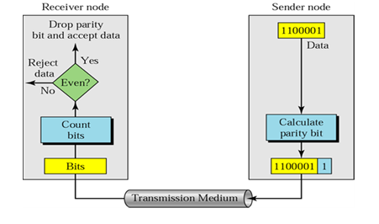
Simple Parity Check:

Slide 30
Two Dimensional Parity Check:
A block of bits is organized in a table (rows and columns).
First we calculate the parity bit for each data unit.
Then we organize them into table.
Shows in fig we have four data units shown in four rows and eight columns.

Slide 31
Two Dimensional Parity Check:
We then calculate the parity bit for each column and create a new row of 8 bits.
They are the parity bits for the whole block.
The first parity bit in the fifth row is calculated based on all first bits; the second parity bit is calculated based on all second bits, and so on.
We then attach the 8 parity bits to the original data and sent them to the receiver.

Slide 32
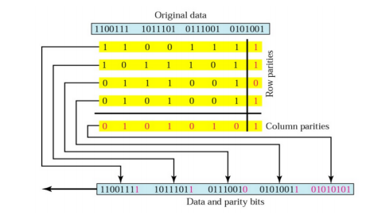
Two Dimensional Parity Check:

Slide 33
Check sum :
It is based on the concept of redundancy.
The unit is divided into K sections, each of n bits.
All sections are added using ones complement to get the sum.
This is complemented and becomes the check sum.
There after this check sum is sent with the data.
At the receiver side the unit is divided into K sections each of n bits.
All sections are added using ones complement to get the sum.
The sum is complemented. If the result is zero data are accepted otherwise rejected.

Slide 34
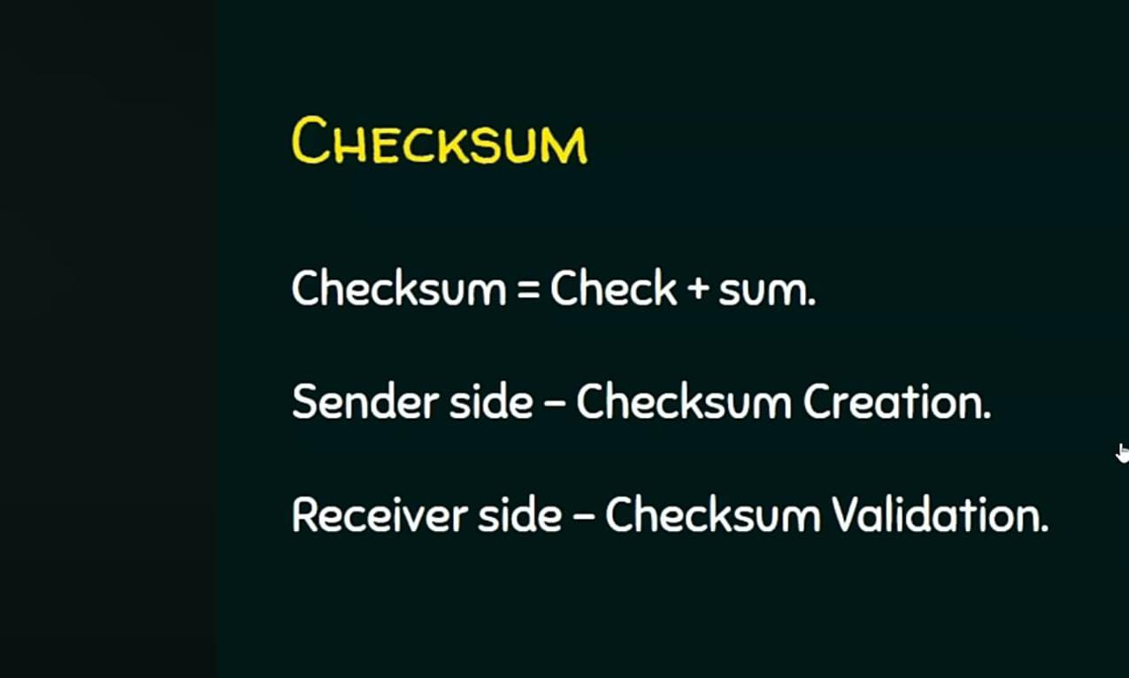

Slide 35
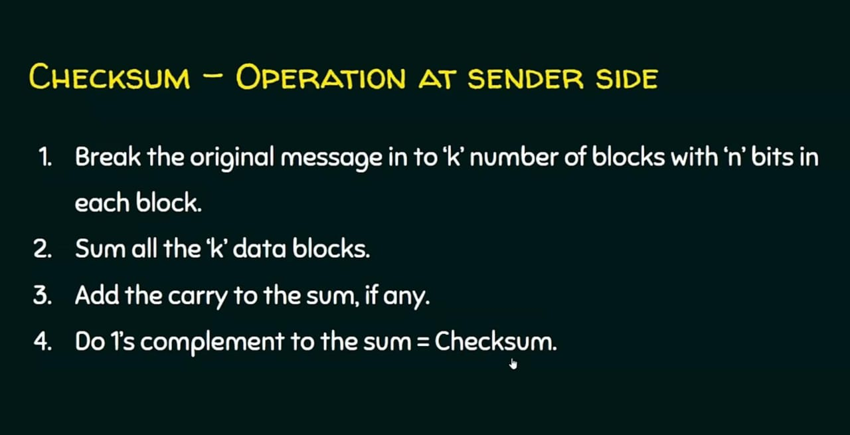

Slide 36
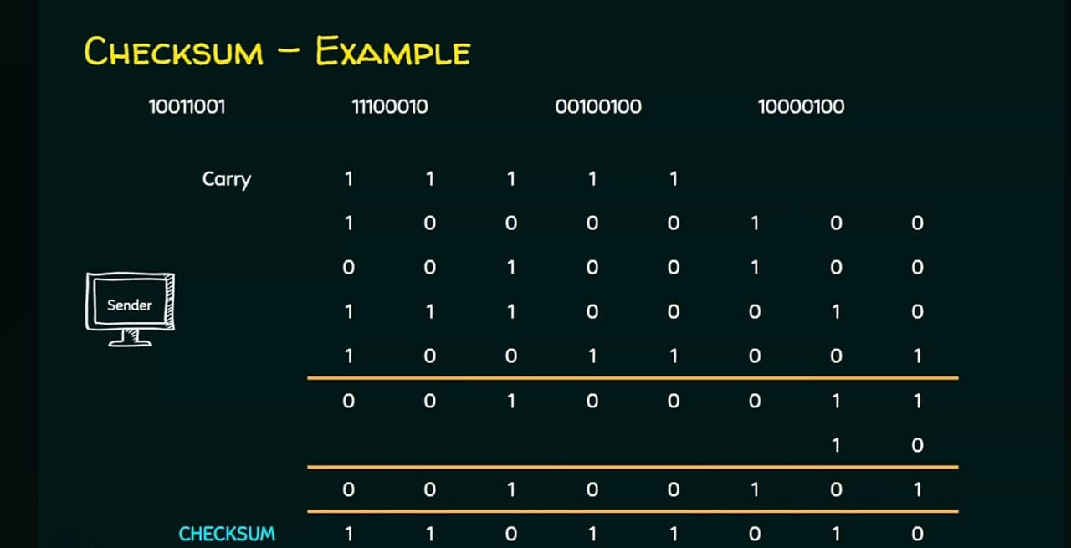

Slide 37
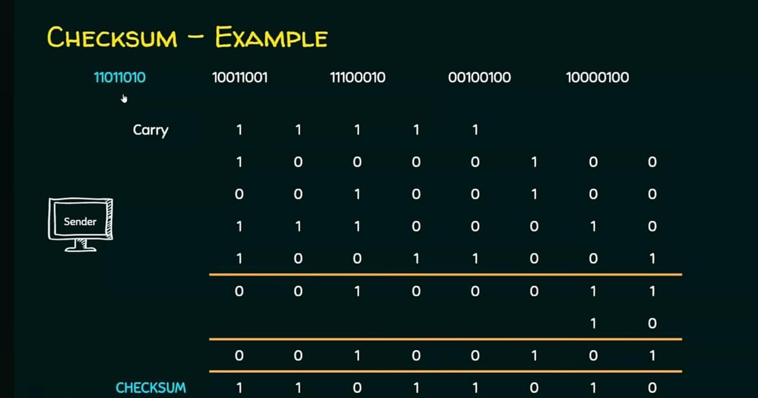

Slide 38
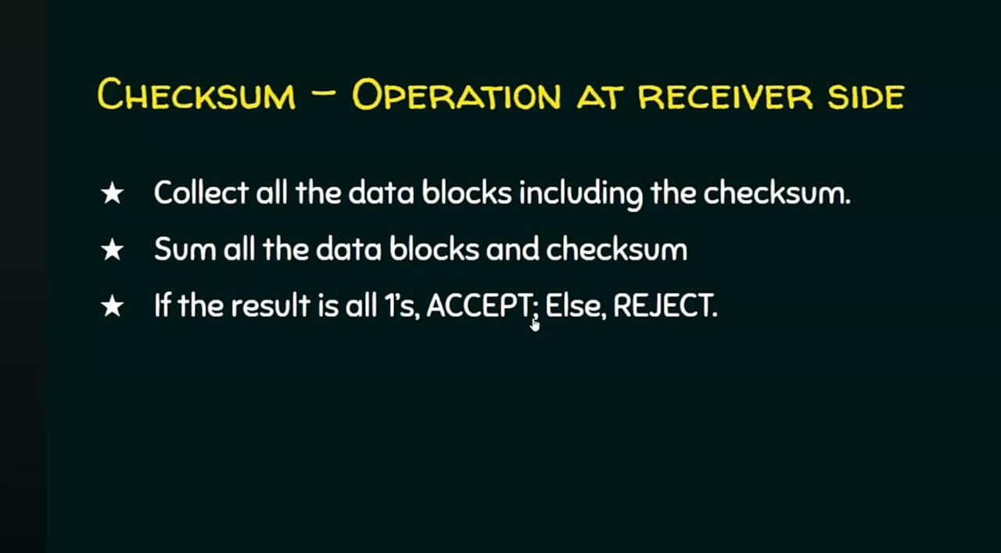

Slide 39
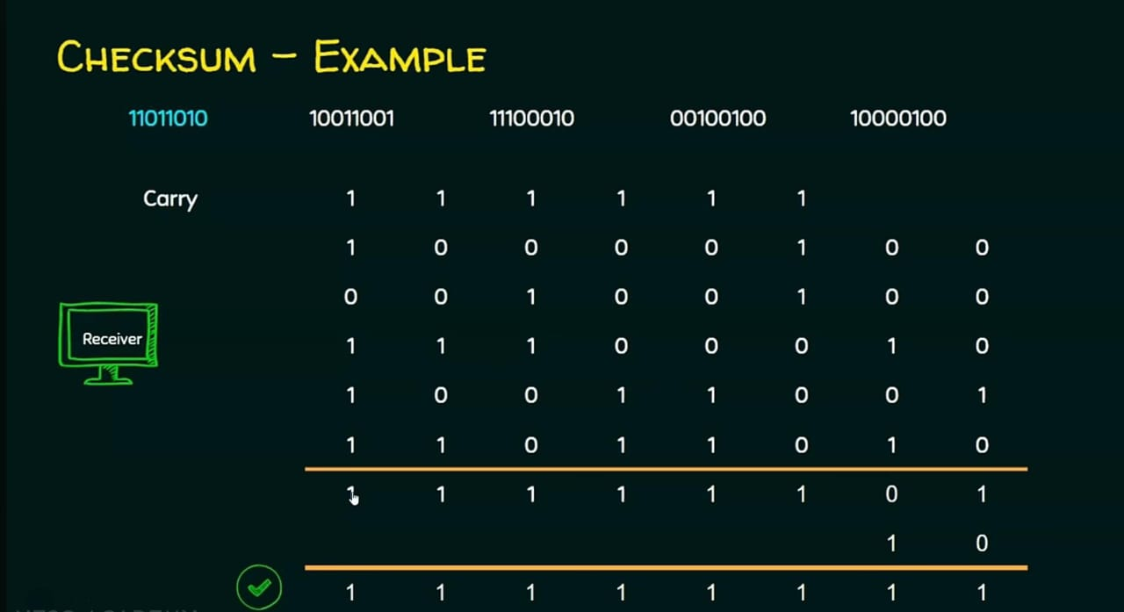

Slide 40
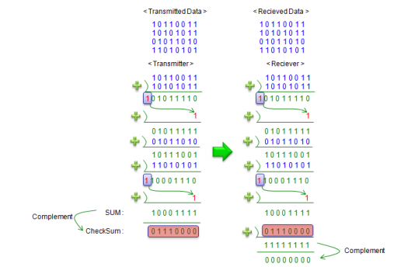
Check sum :
At the receiver side the unit is divided into K sections each of n bits.
All sections are added using ones complement to get the sum.
The sum is complemented. If the result is zero data are accepted otherwise rejected.

Slide 41
QUIZ 3:
1) In ________ error correction, the receiver asks the sender to send the data again.
A) forward
B) backward
C) retransmission
D) none of the above
ANSWER: C

Slide 42
QUIZ 3:
The _____of errors is more difficult than the ______.
A) detection; correction
B) correction; detection
C) creation; correction
D) creation; detection
ANSWER: B

Slide 43
SUMMARY:
Error Detection and Correction
Parity check Method
Two Dimensional Parity Check
Check sum
Quiz

Slide 44
LECTURE 4:
RECAP
Error Detection and Correction
Parity check Method
Two Dimensional Parity Check
Check sum
Quiz
AGENDA
Error Detection and Correction
CRC method of Error Detection
Quiz

Slide 45
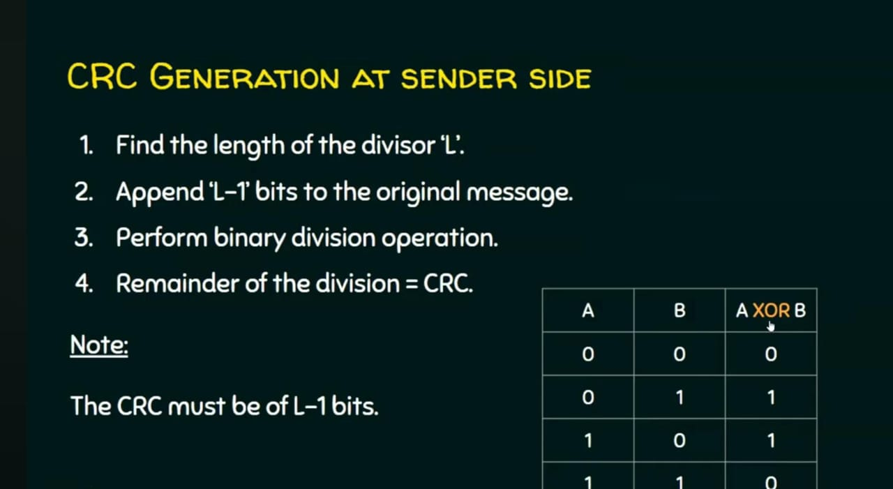
Cyclic Redundancy Check (CRC)

Slide 46
CRC:CRC helps ensure that the data received is identical to the data sent. It does not correct the errors, only detects them.
Sender Side:
The original data is treated as a large binary number.
It is divided by a predetermined binary number (called the generator polynomial).
The remainder of this division is called the CRC checksum.
This checksum is appended to the data and sent.

Slide 47
CRC-Receiver Side:
The receiver performs the same division on the received data (original + checksum).
If the remainder is 0, the data is assumed to be error-free.
If not, an error is detected.

Slide 48
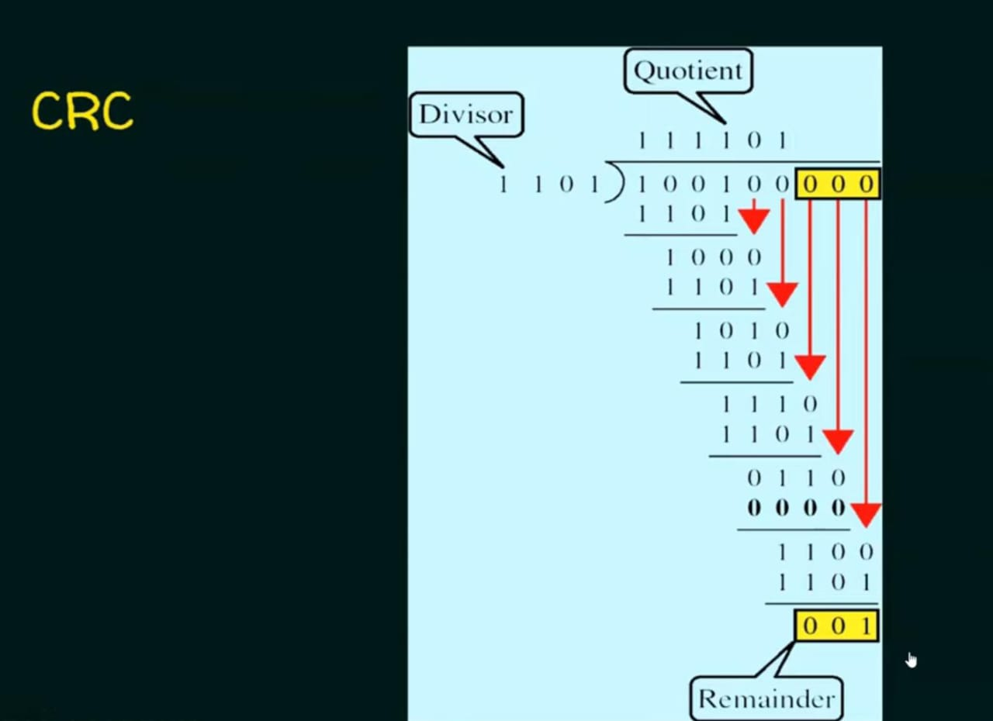

Slide 49
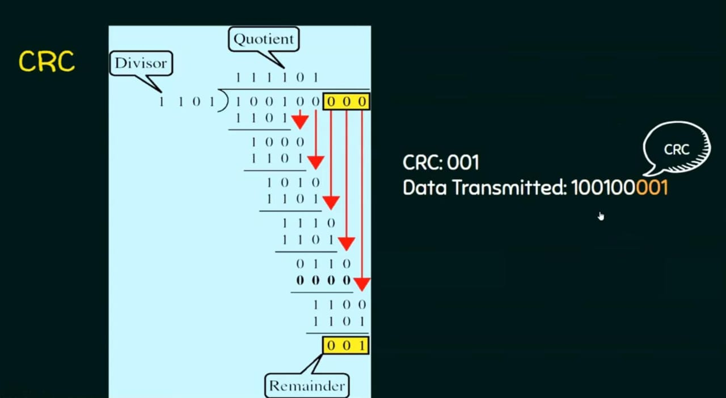

Slide 50
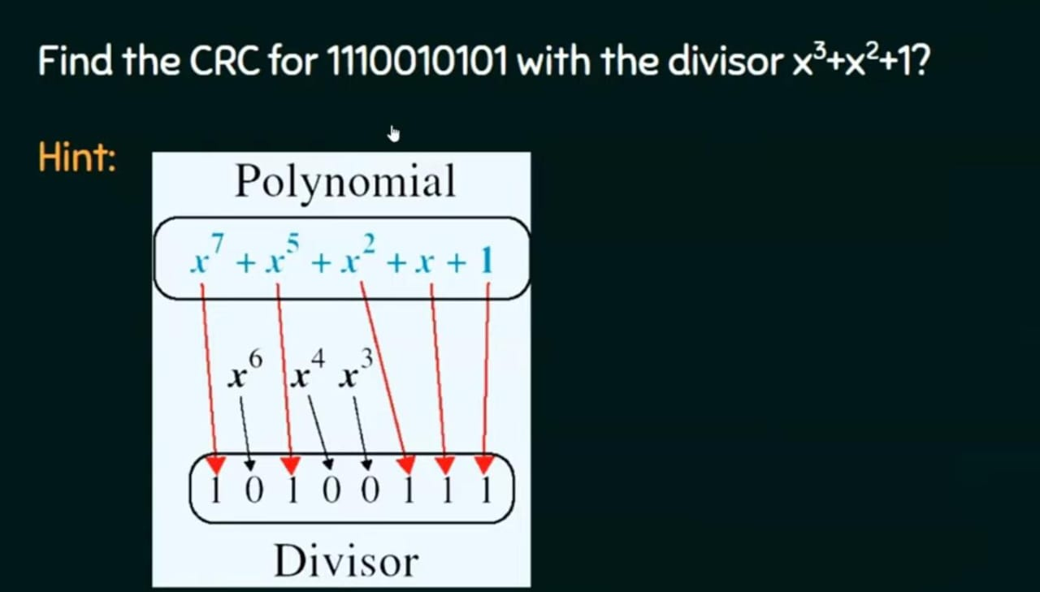

Slide 51
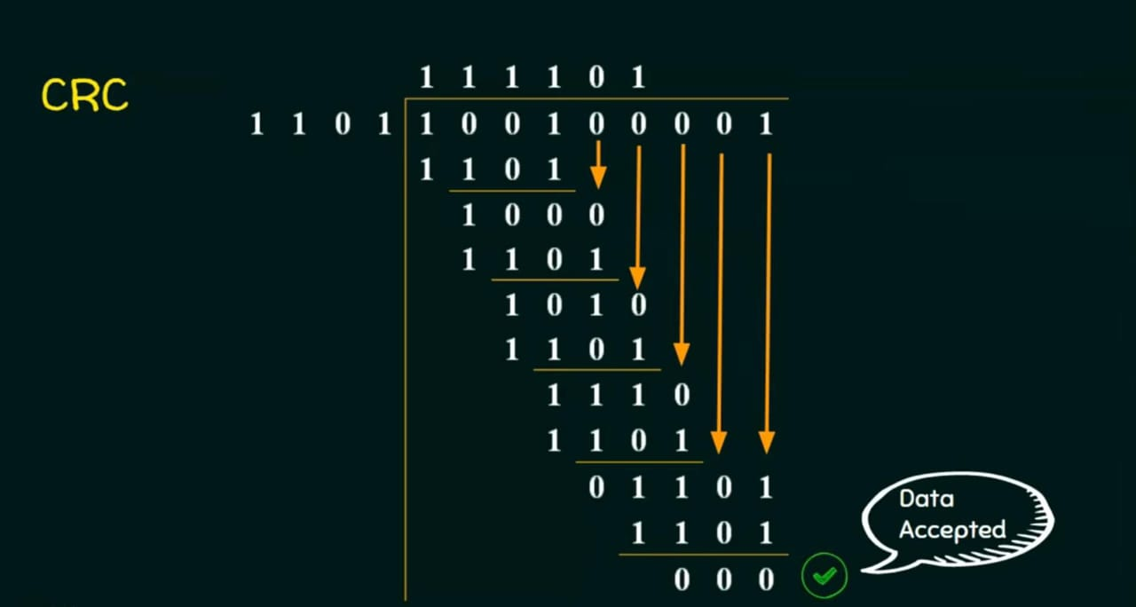

Slide 52
CRC method of Error Detection:
It is the most powerful mechanism of error detecting.
Algorithms for computing the CRC:
Step1:
Let ‘r’ be the degree of generator polynomial G(x).
Multiply the message frame M(x) by Xr . This is done by adding ‘r’ zero bits to the low order message bit.
Now the message frame M(x) corresponds to the polynomial XrM(x).

Slide 53
CRC method of Error Detection:
Step 2:
Divide the appended polynomial XrM(x) by G(x) using modulo-2 division to obtain the reminder r(x).
Step 3:
Add the reminder r(x) to low order Xr .M(x) using modulo-2 addition. The resultant code is the check summed frame or the CRC code to be transmitted.
This CRC is considered as T(X).

Slide 54
CRC method of Error Detection:
Step 4:
The receiver while divide the T(x) with G(x) using modulo-2 division.
Step 5:
If the result of this division gives a remainder as „0‟ then the data is accepted else it is discarded.

Slide 55
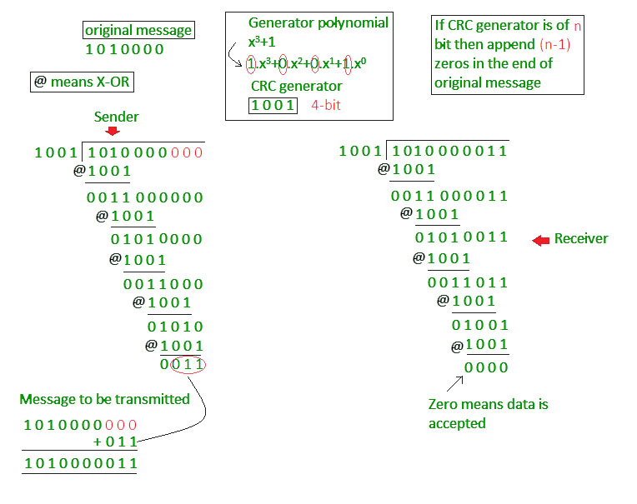
CRC method of Error Detection:

Slide 56
Hamming CODE
Hamming code is an error-correcting code used to ensure data accuracy during transmission or storage.
Hamming code detects and corrects the errors that can occur when the data is moved or stored from the sender to the receiver.
This simple and effective method helps improve the reliability of communication systems and digital storage.
It adds extra bits to the original data, allowing the system to detect and correct single-bit errors.
It is a technique developed by Richard Hamming in the 1950s.

Slide 57
What is Redundant Bits?
Redundant bits are extra binary bits that are generated and added to the information-carrying bits of data transfer to ensure that no bits were lost during the data transfer.
Types of Parity Bits
A parity bit is a bit appended to a data of binary bits to ensure that the total number of 1’s in the data is even or odd. Parity bits are used for error detection. There are two types of parity bits:
Even Parity Bit: In the case of even parity, for a given set of bits, the number of 1’s are counted. If that count is odd, the parity bit value is set to 1, making the total count of occurrences of 1’s an even number. If the total number of 1’s in a given set of bits is already even, the parity bit's value is 0.
Odd Parity Bit: In the case of odd parity, for a given set of bits, the number of 1’s are counted. If that count is even, the parity bit value is set to 1, making the total count of occurrences of 1’s an odd number. If the total number of 1’s in a given set of bits is already odd, the parity bit's value is 0.

Slide 58
Algorithm of Hamming Code
Hamming Code is simply the use of extra parity bits to allow the identification of an error.
Step 1: Write the bit positions starting from 1 in binary form (1, 10, 11, 100, etc).
Step 2: All the bit positions that are a power of 2 are marked as parity bits (1, 2, 4, 8, etc).
Step 3: All the other bit positions are marked as data bits.
Step 4: Each data bit is included in a unique set of parity bits, as determined its bit position in binary form:
Step 5: Since we check for even parity set a parity bit to 1 if the total number of ones in the positions it checks is odd. Set a parity bit to 0 if the total number of ones in the positions it checks is even.

Slide 59
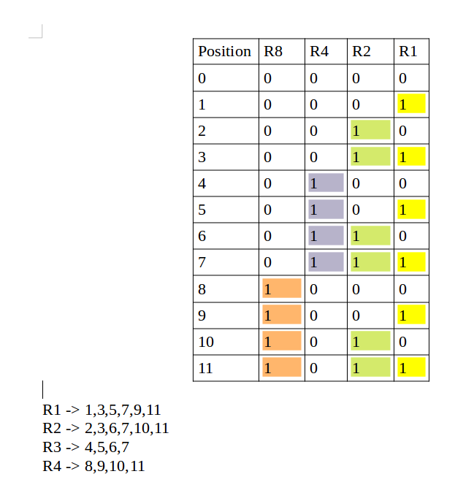

Slide 60
QUIZ 4:
In modulo-2 arithmetic, we use the ______ operation for both addition and subtraction.
A) OR
B) XOR
C) AND
D) none of the above
Answer: B

Slide 61
QUIZ 4:
2. In modulo-2 arithmetic, __________ give the same results.
A) addition and subtraction
B) addition and multiplication
C) addition and division
D) none of the above
Answer: A

Slide 62
SUMMARY:
Error Detection and Correction
CRC method of Error Detection
Quiz

Slide 63
LECTURE 5:
RECAP
Error Detection and Correction
CRC method of Error Detection
Quiz
AGENDA
Stop and wait ARQ
GO-BACK-N ARQ
Sequence numbers
Quiz

Slide 64
Channel Allocation Problem
The channel allocation problem in computer networks involves distributing a single communication channel among multiple users to ensure efficient and interference-free communication.
The network channel may be a single cable or optical fiber connecting multiple nodes, or a portion of the wireless spectrum.
Channel allocation algorithms allocate the wired channels and bandwidths to the users, who may be base stations, access points or terminal equipment.

Slide 65
Channel Allocation Schemes
Channel Allocation may be done using two schemes
Static Channel Allocation
Dynamic Channel Allocation

Slide 66
Static Channel Allocation
In static channel allocation, the channel's bandwidth is divided into fixed portions, each assigned to a specific user. This method uses Frequency Division Multiplexing (FDM), where the frequency channel is split into equal-sized sub-channels, and each user gets one sub-channel. This approach ensures no interference between users since each has a private frequency band.
However, static allocation has significant drawbacks:
Inefficiency with Variable Users: It is not suitable for networks with a large number of users or variable bandwidth requirements.
Wasted Bandwidth: If some users are inactive, their allocated bandwidth remains unused, leading to inefficiency.

Slide 67
Dynamic Channel Allocation
In dynamic channel allocation scheme, frequency bands are not permanently assigned to the users.
Instead channels are allotted to users dynamically as needed, from a central pool. The allocation is done considering a number of parameters so that transmission interference is minimized.
This allocation scheme optimises bandwidth usage and results is faster transmissions.
Dynamic allocation can be further divided into 2 types:
Centralized Allocation: A central authority manages the allocation of channels.
Distributed Allocation: Allocation decisions are made locally by the users or devices

Slide 68
Assumptions in Dynamic Channel Allocation
Dynamic channel allocation operates under several assumptions:
Independent Traffic: Each station independently generates frames for transmission.
Single Channel: All stations share a single channel for sending and receiving data.
Observable Collisions: Collisions are detectable, and collided frames must be retransmitted.
Continuous or Slotted Time: Time can be divided into slots, and frame transmission starts at the beginning of a slot.
Carrier Sense or No Carrier Sense: Stations can sense if the channel is busy before transmitting

Slide 69
ARQ Protocols (Automatic Repeat Request):
Error detection is one of the responsibilities of data link layer.
If any error is detected in the transmission, specified frames are retransmitted. This process is called Automatic Repeat Request.
The set of rules that will determine the operations for the sender and the receiver are named the ARQ protocols.
Three Commonly used ARQ Protocols are:
Stop and Wait ARQ
Go Back N ARQ
Selective Repeat ARQ

Slide 70
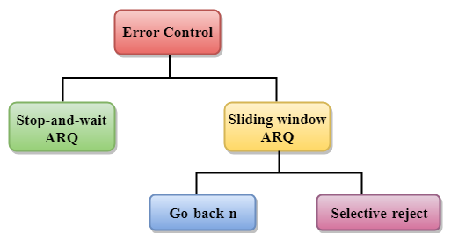
ARQ Protocols (Automatic Repeat Request):

Slide 71
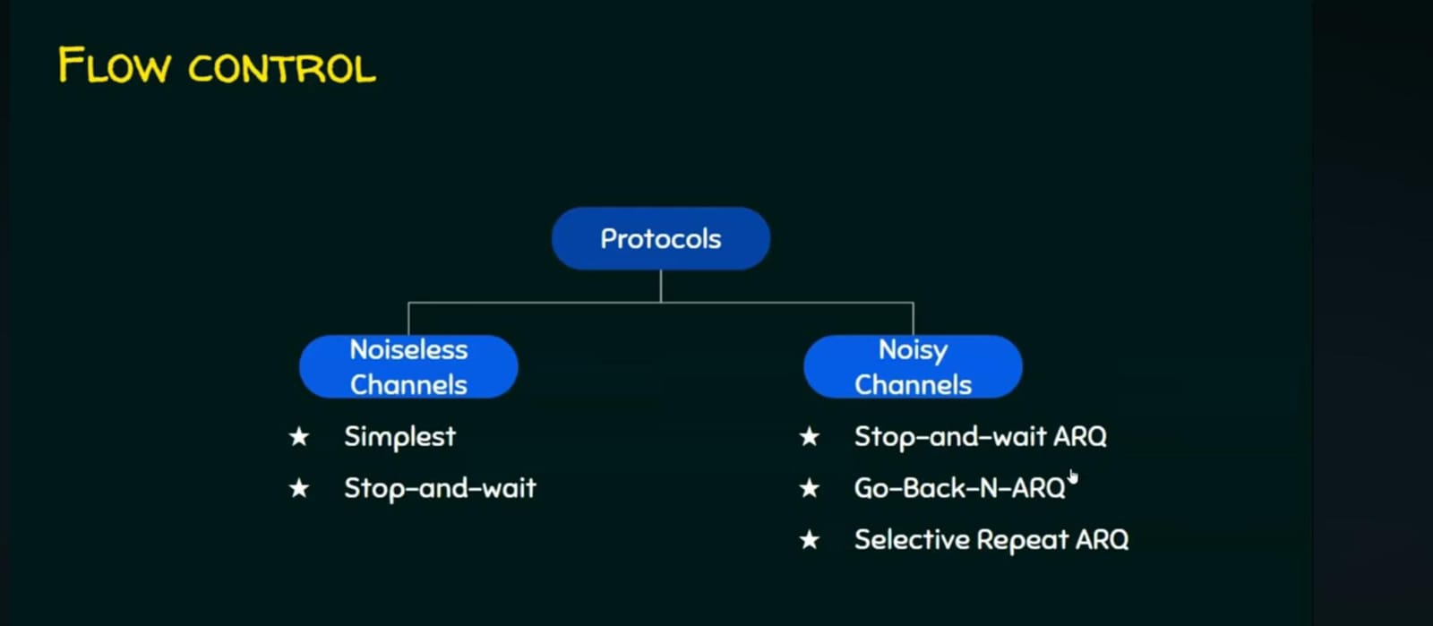

Slide 72
Noisy Channel
A communication channel where errors or distortions can occur during data transmission.
Cause: Noise from the environment, interference, hardware limitations, etc.
Effect: The receiver might receive incorrect or altered data.
Example: A weak cellphone signal causing dropped words during a call.
Noiseless Channel
An ideal communication channel where no errors occur during data transmission.
Effect: The received message is exactly the same as the transmitted one.
Example:Fiber Optic Communication

Slide 73
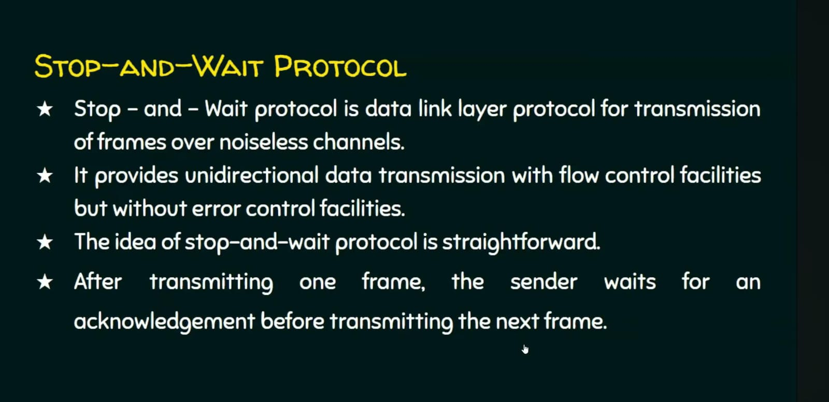

Slide 74
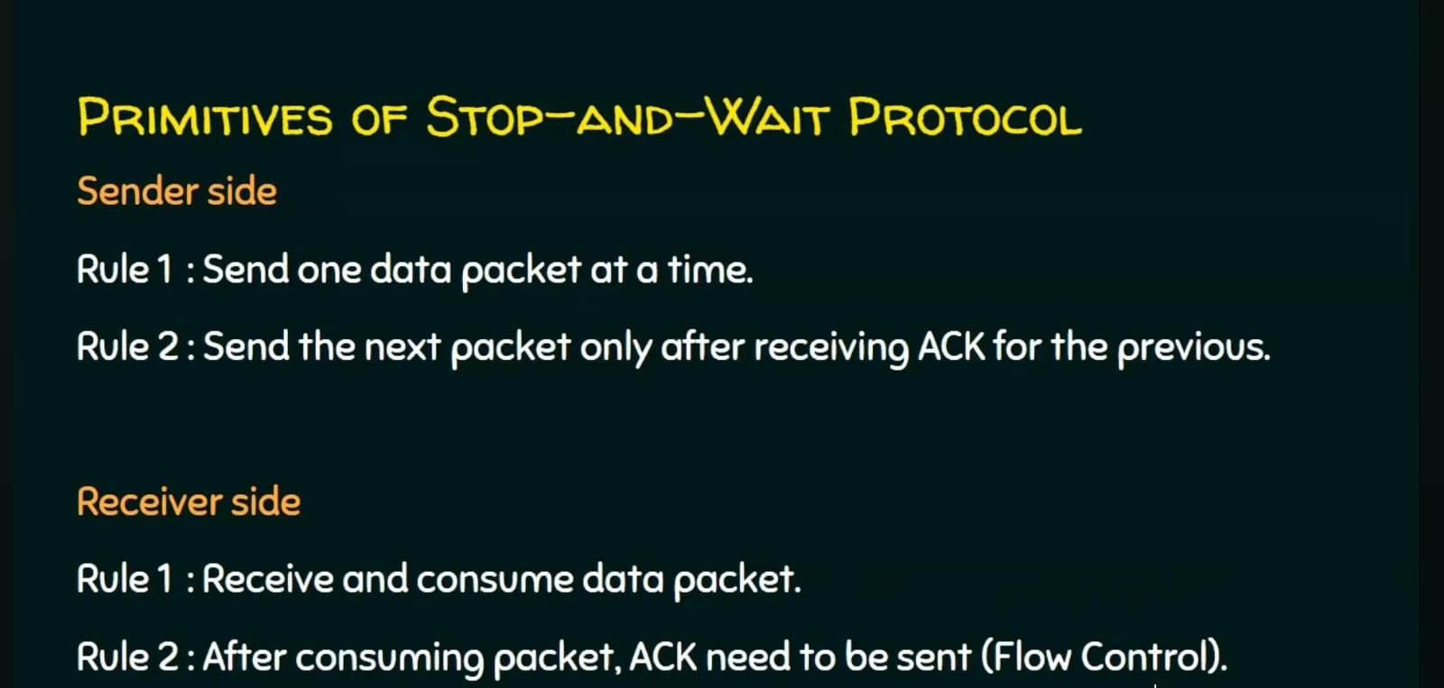

Slide 75
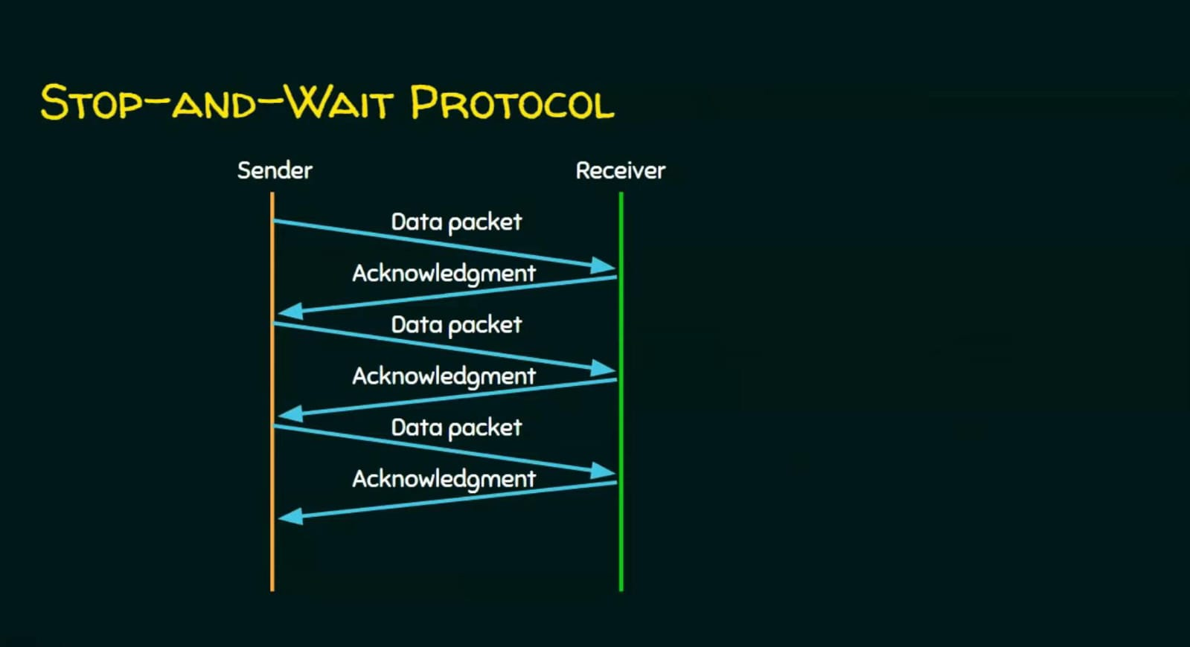

Slide 76
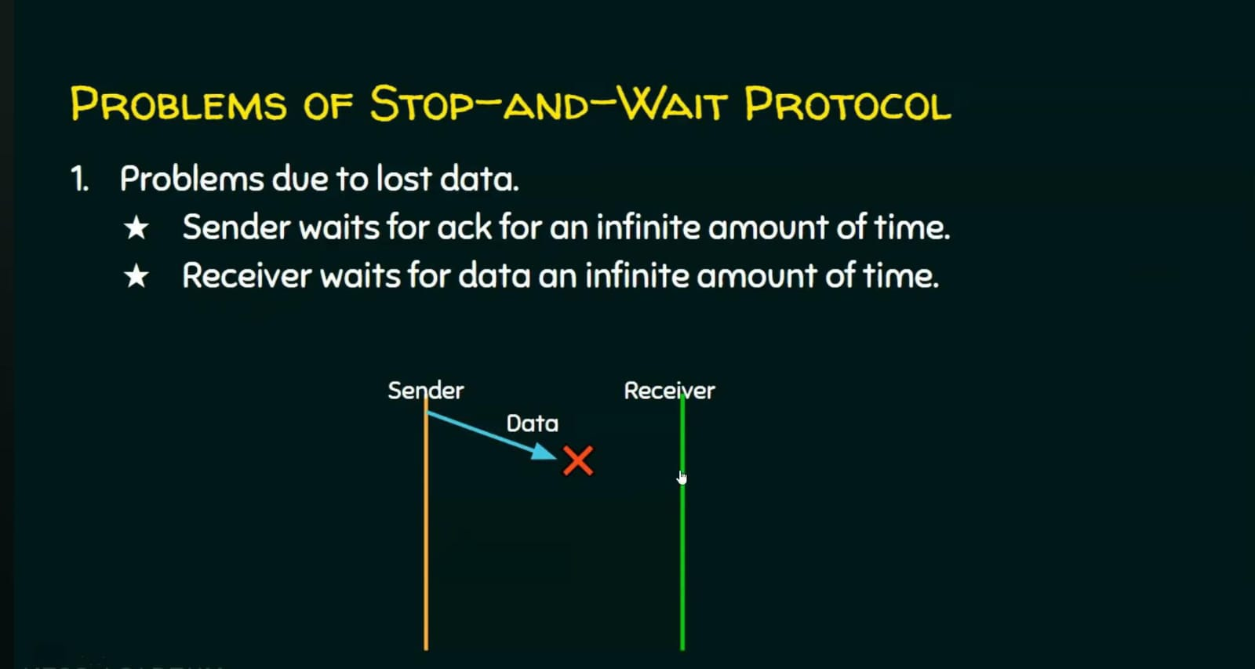

Slide 77
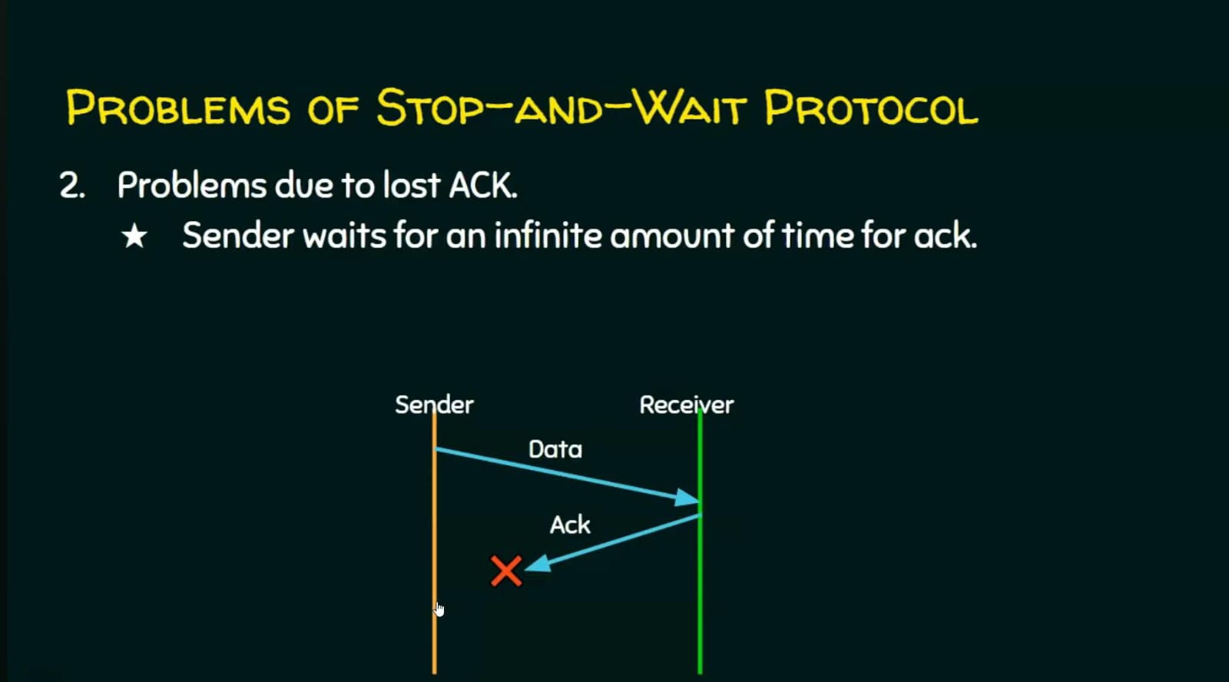

Slide 78
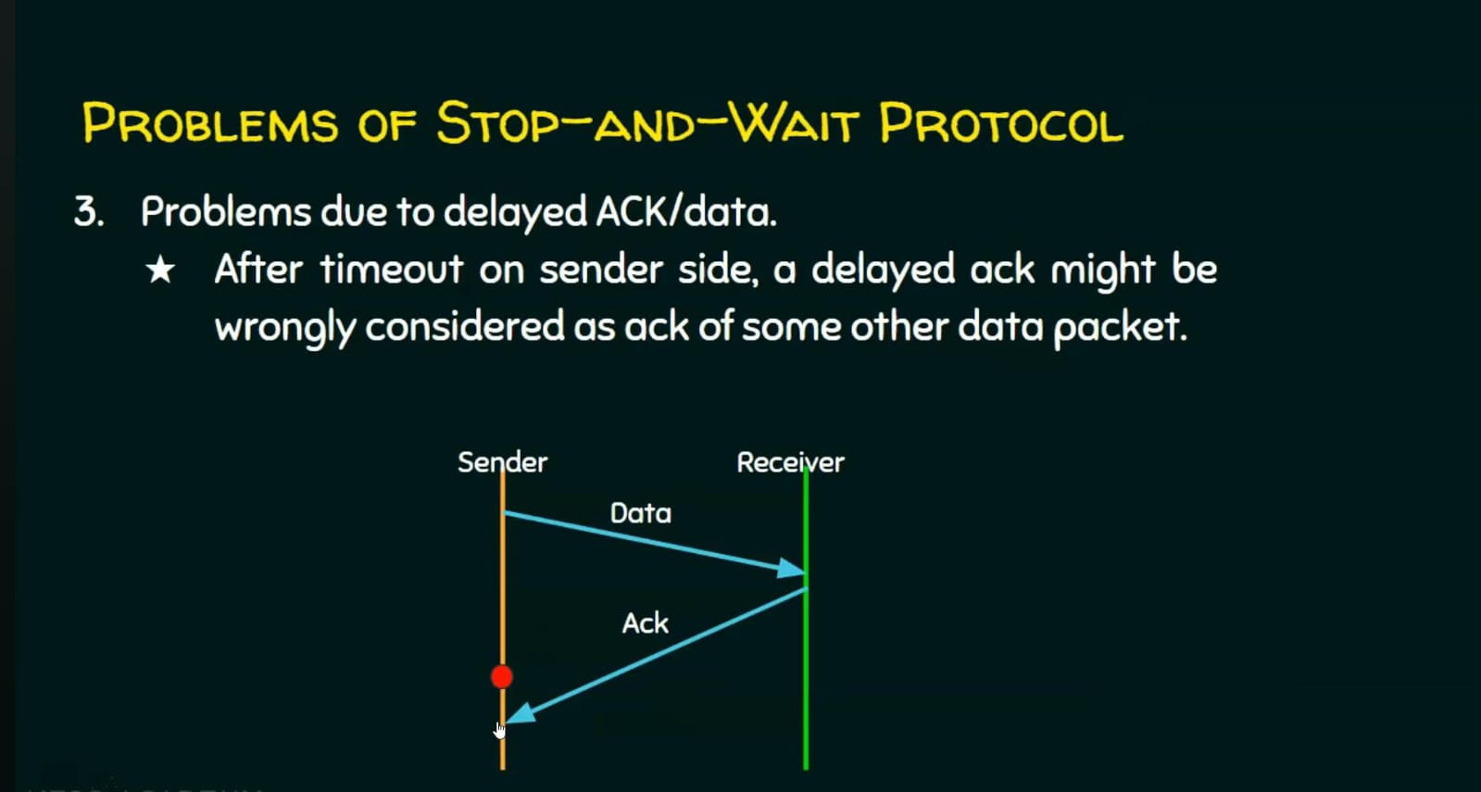

Slide 79
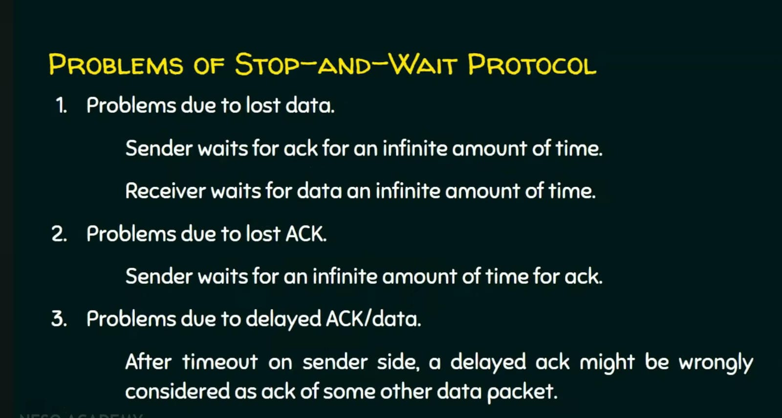

Slide 80
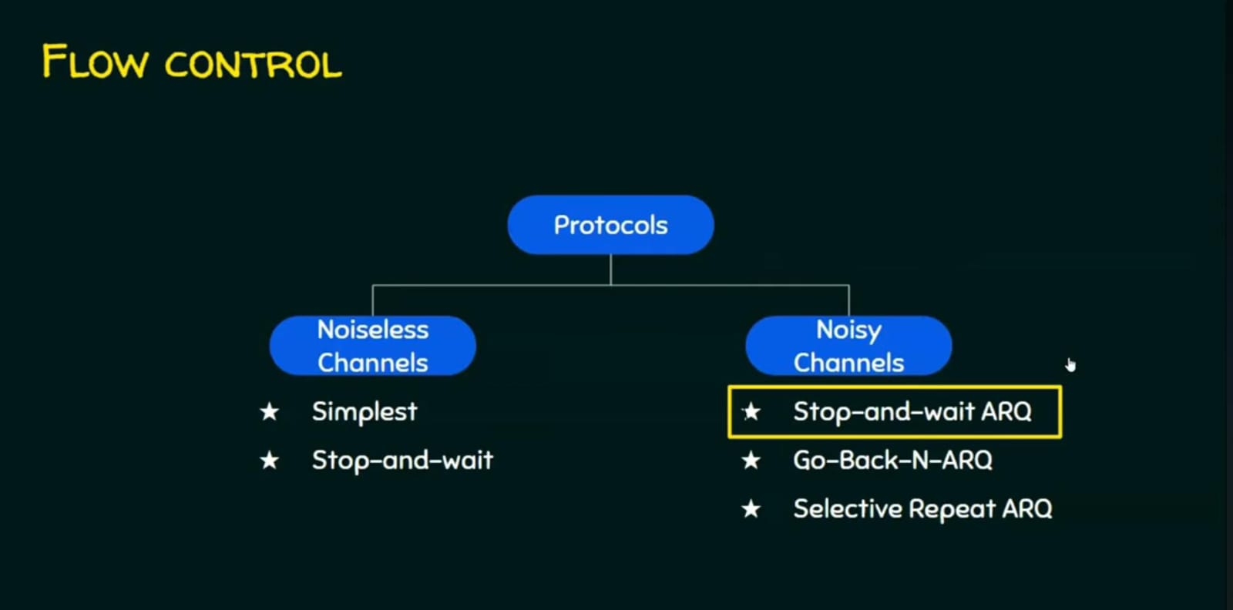

Slide 81
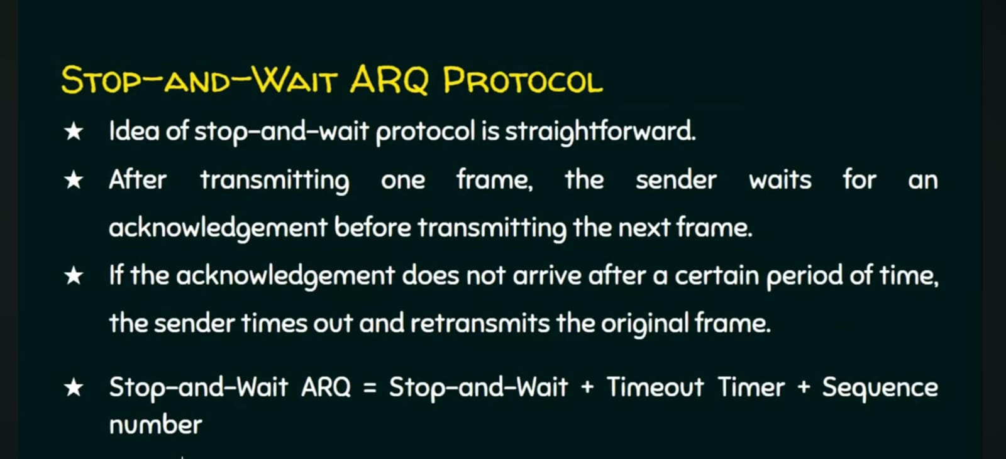
Stop and Wait Automatic Repeat reQuest

Slide 82
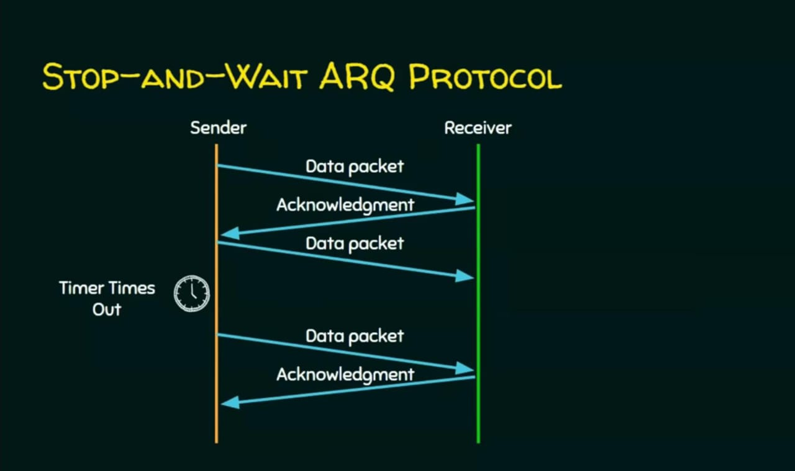

Slide 83
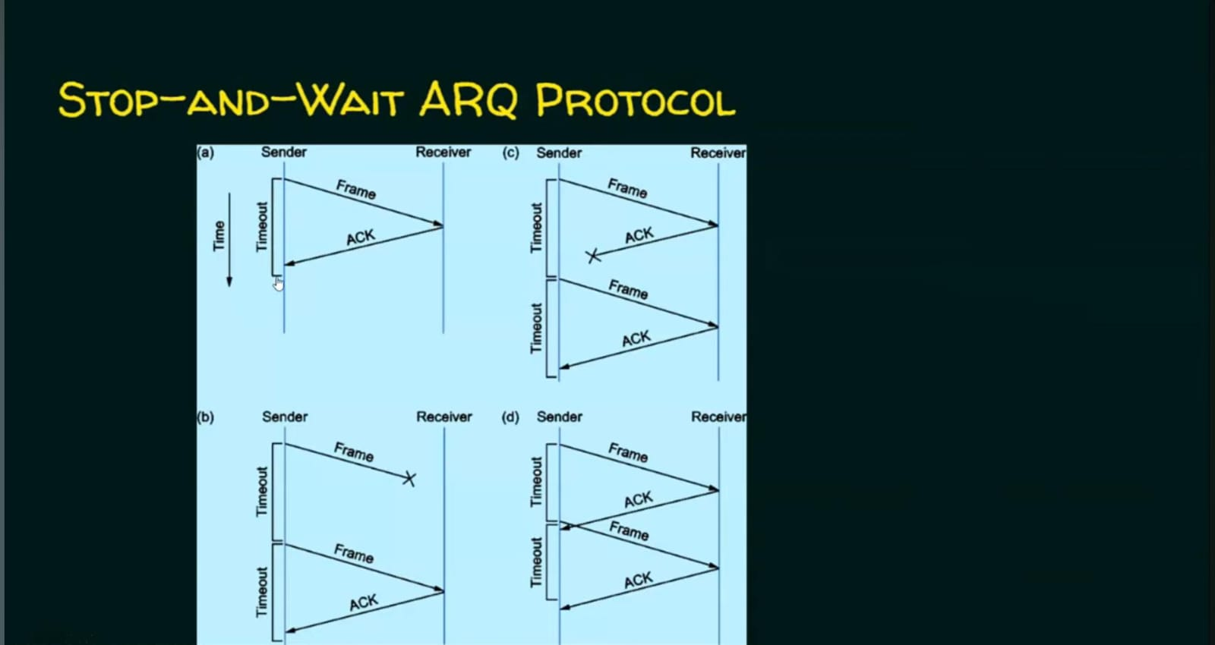

Slide 84
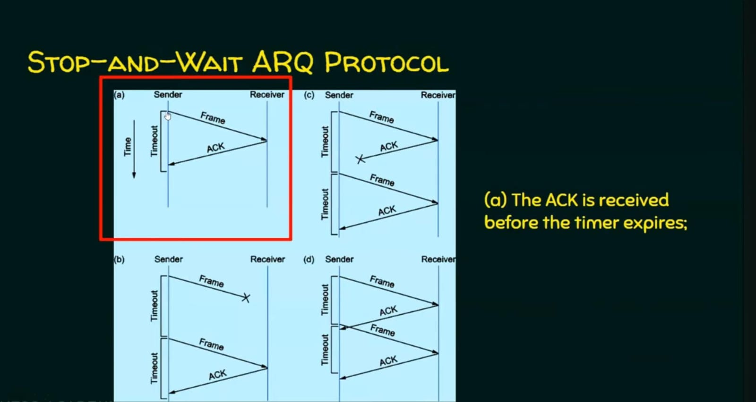

Slide 85
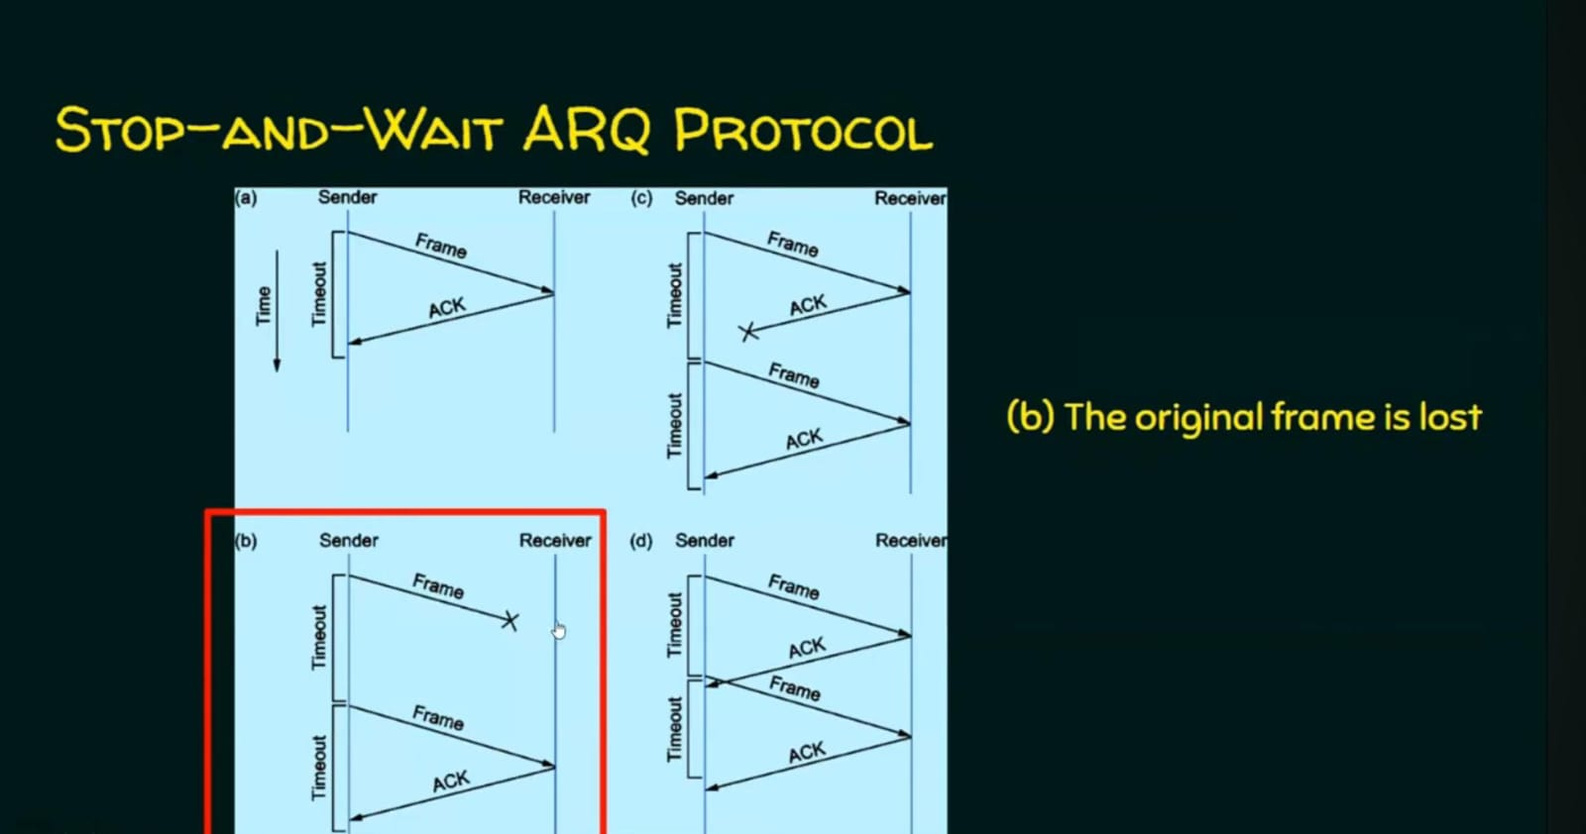

Slide 86


Slide 87


Slide 88
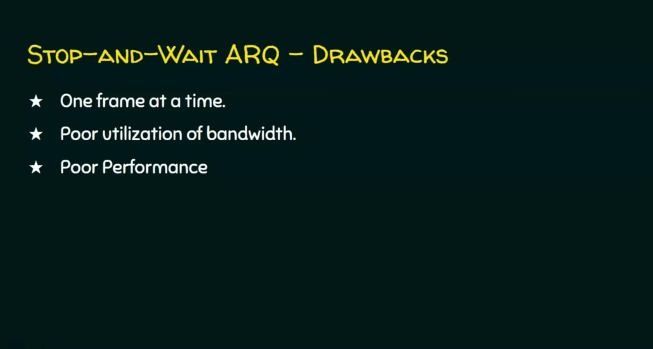

Slide 89
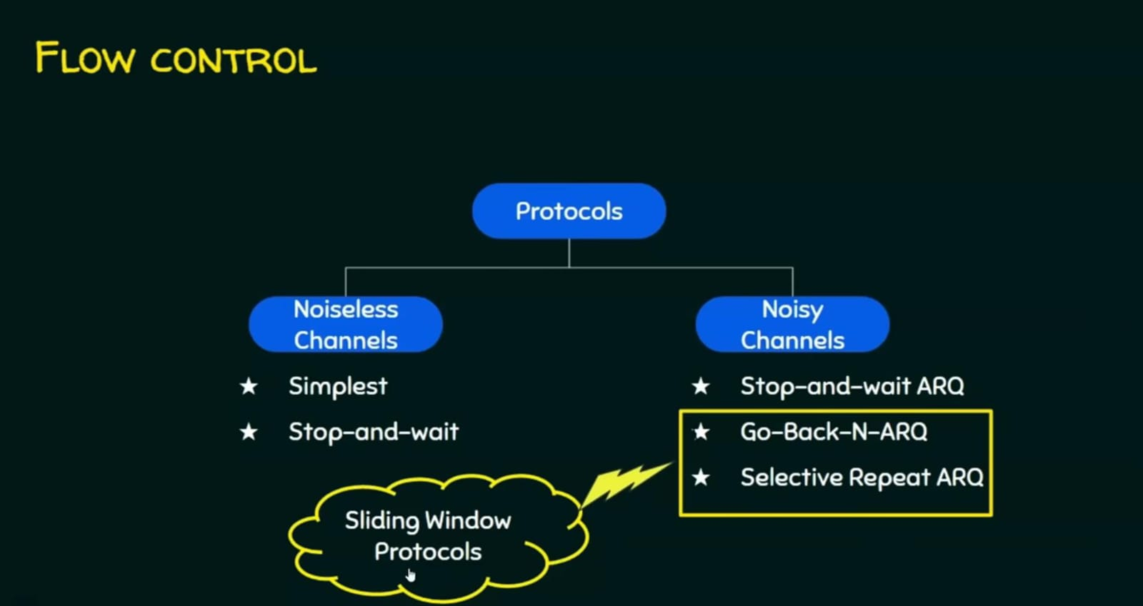

Slide 90
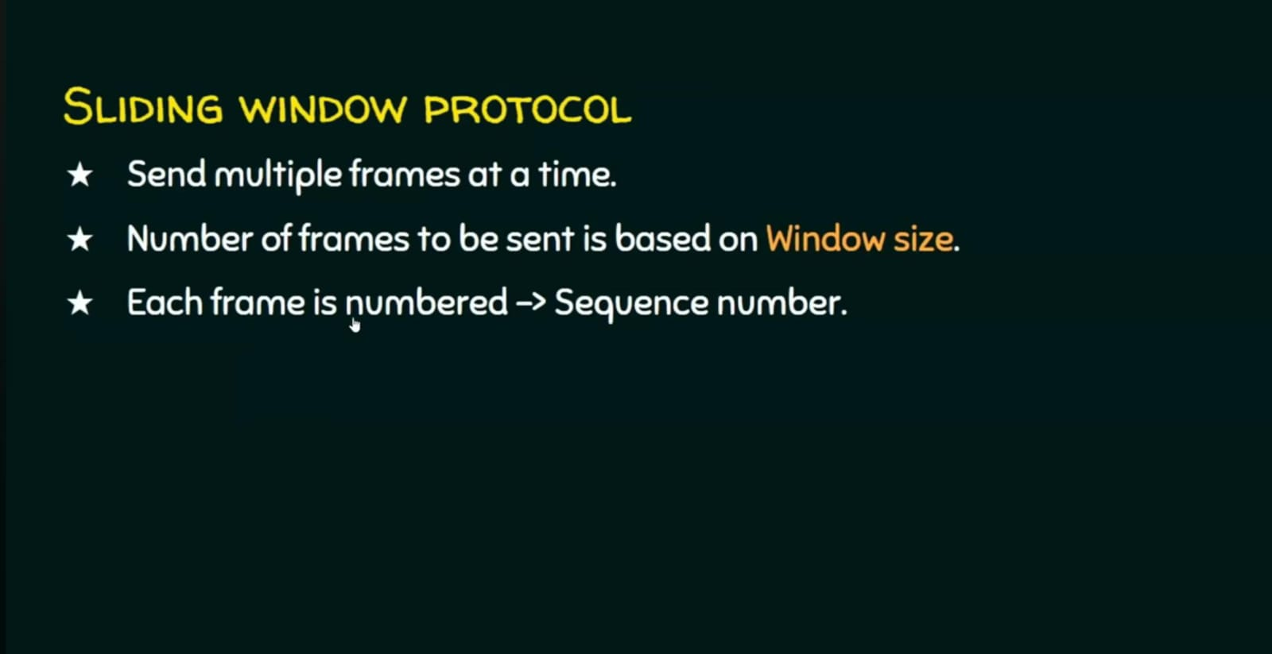

Slide 91
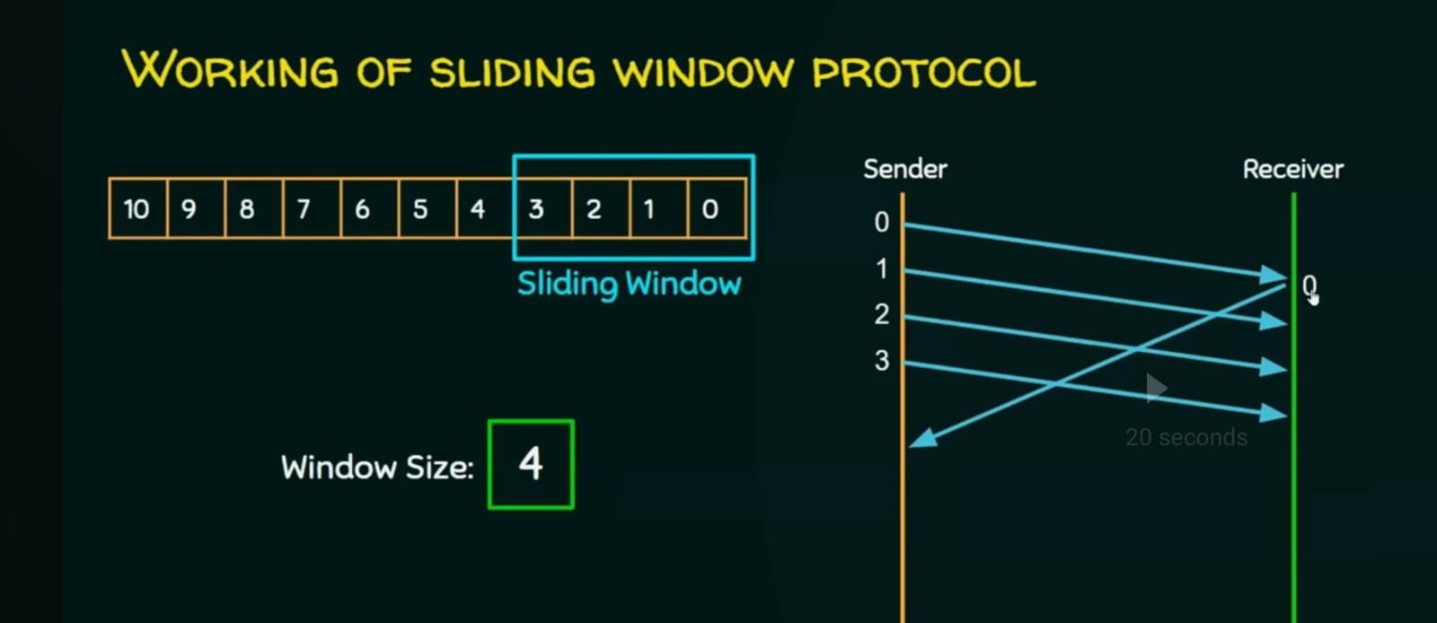

Slide 92
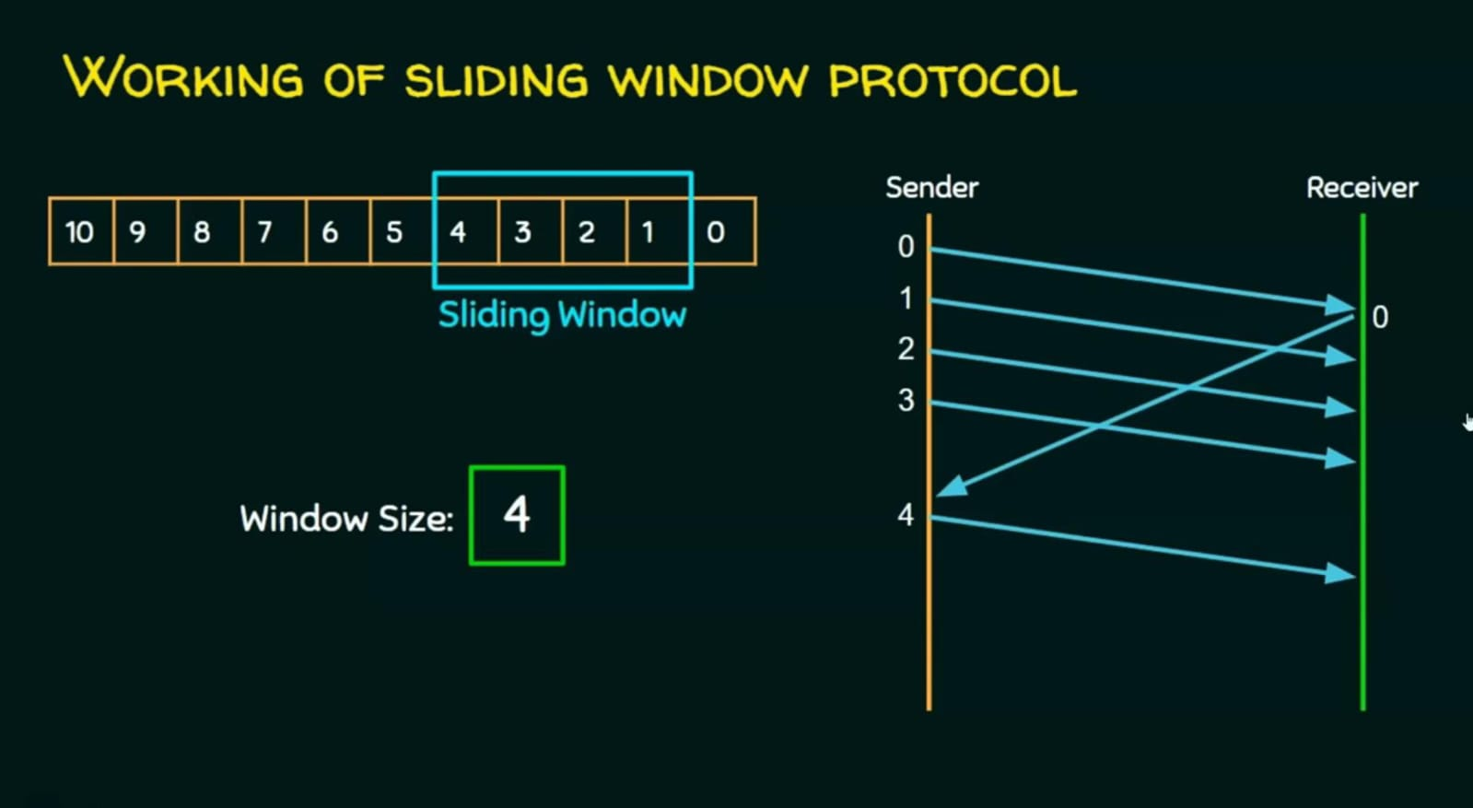

Slide 93
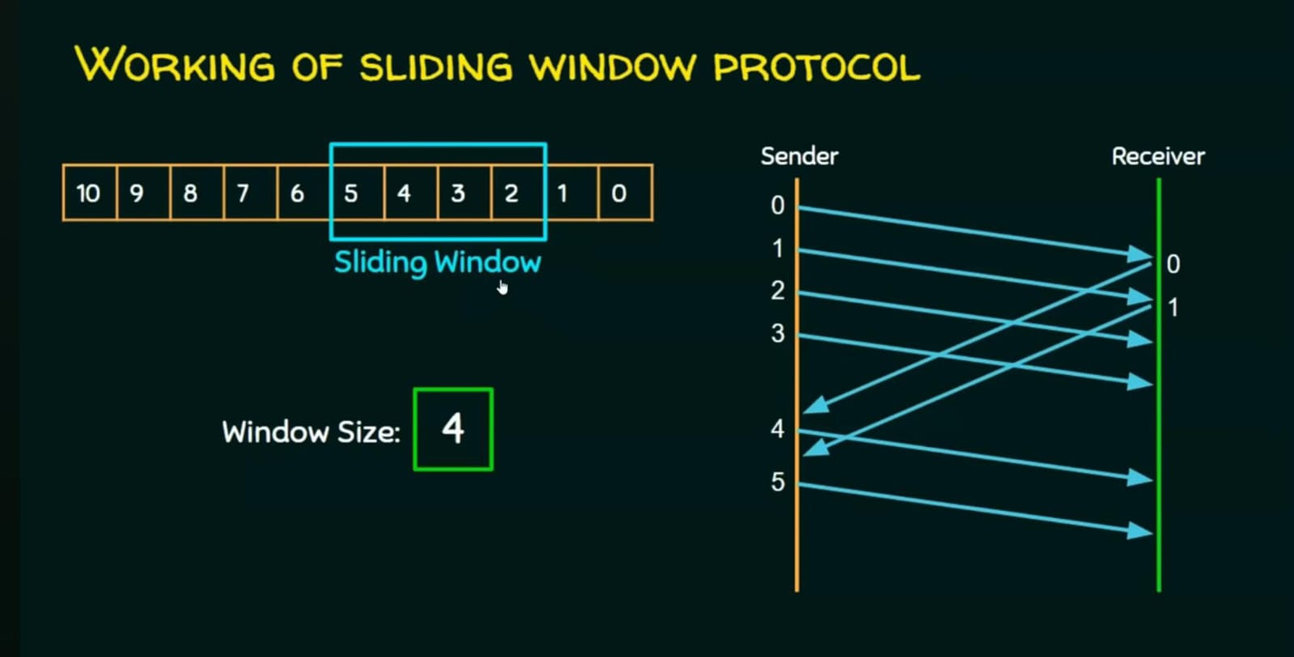

Slide 94
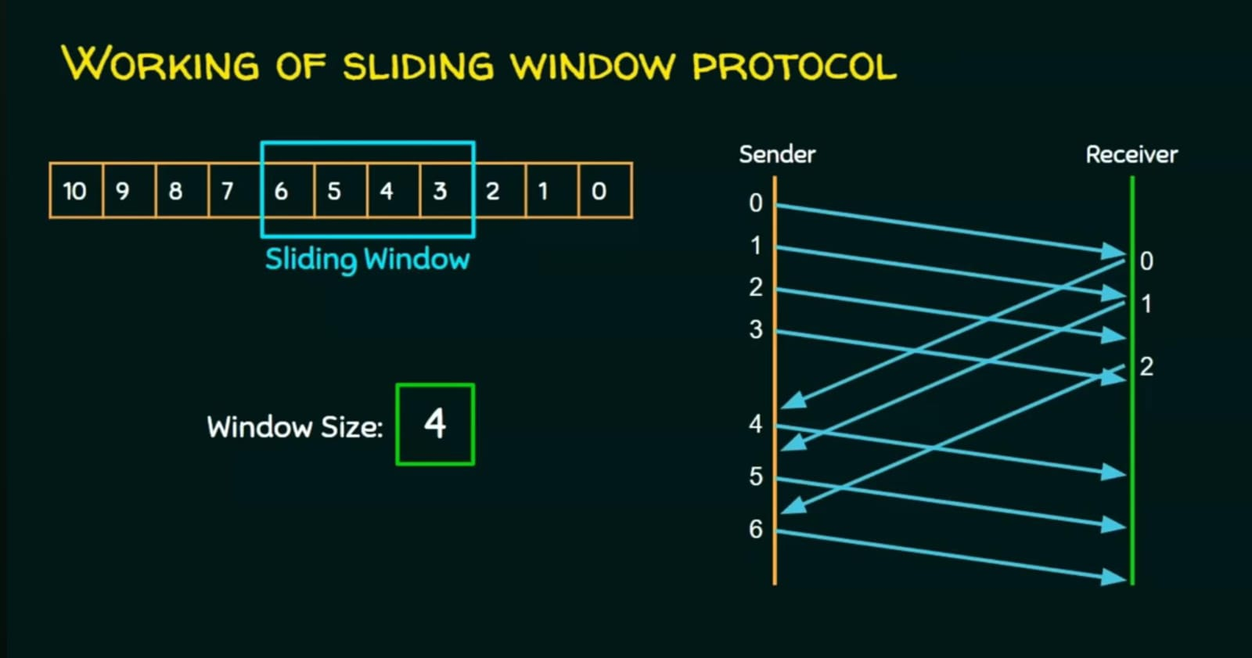

Slide 95
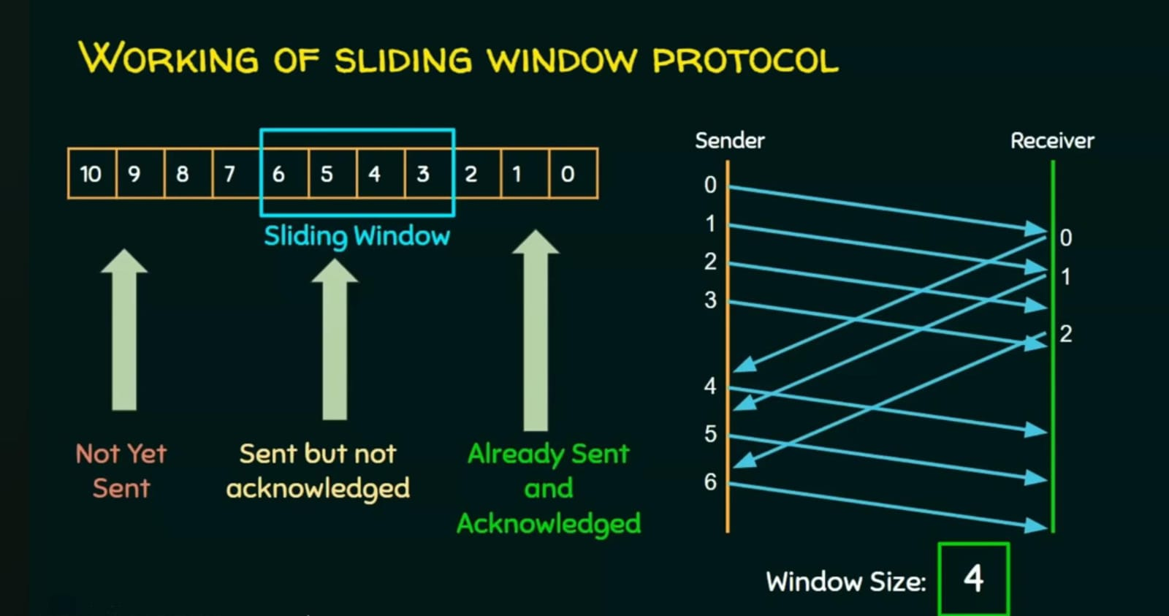

Slide 96
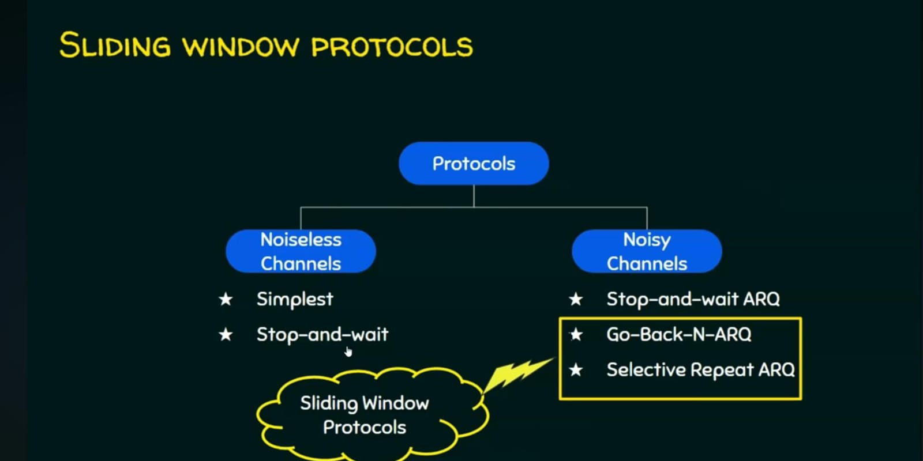

Slide 97
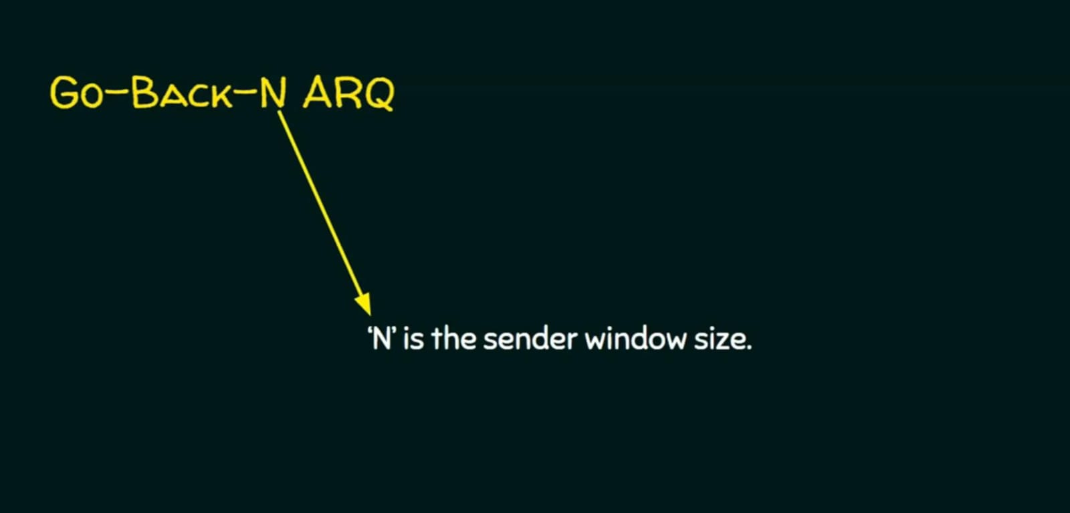

Slide 98
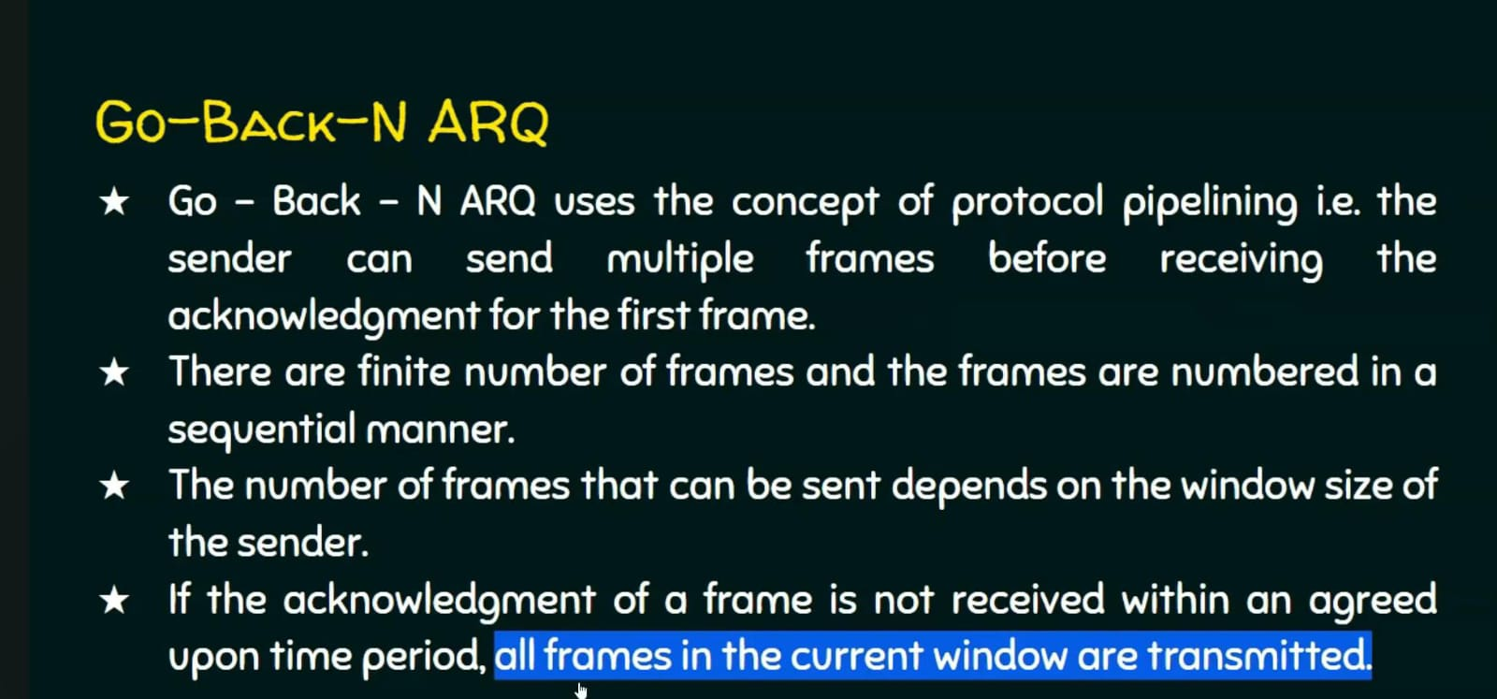

Slide 99
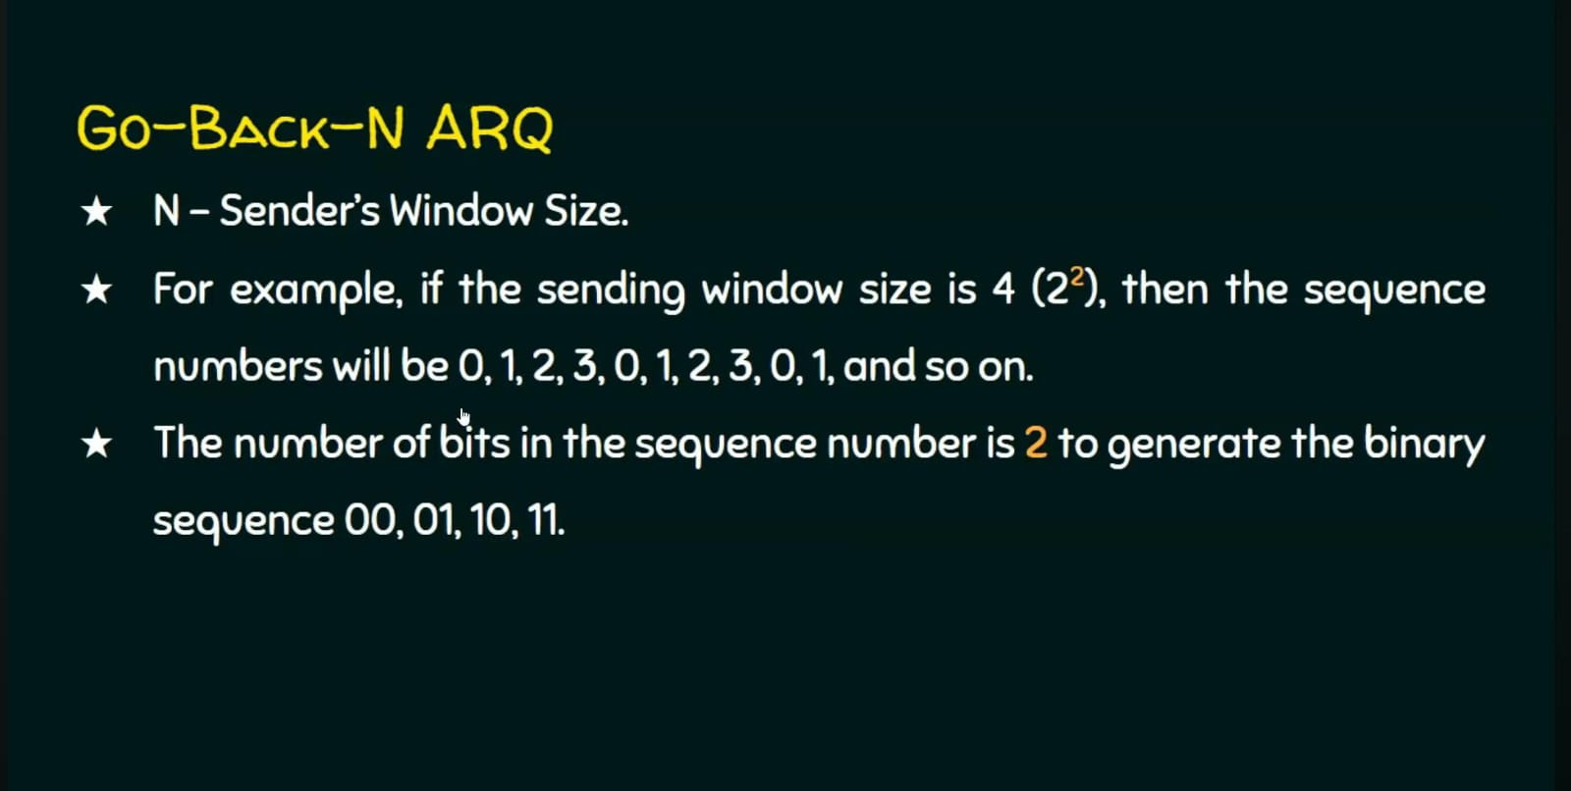

Slide 100
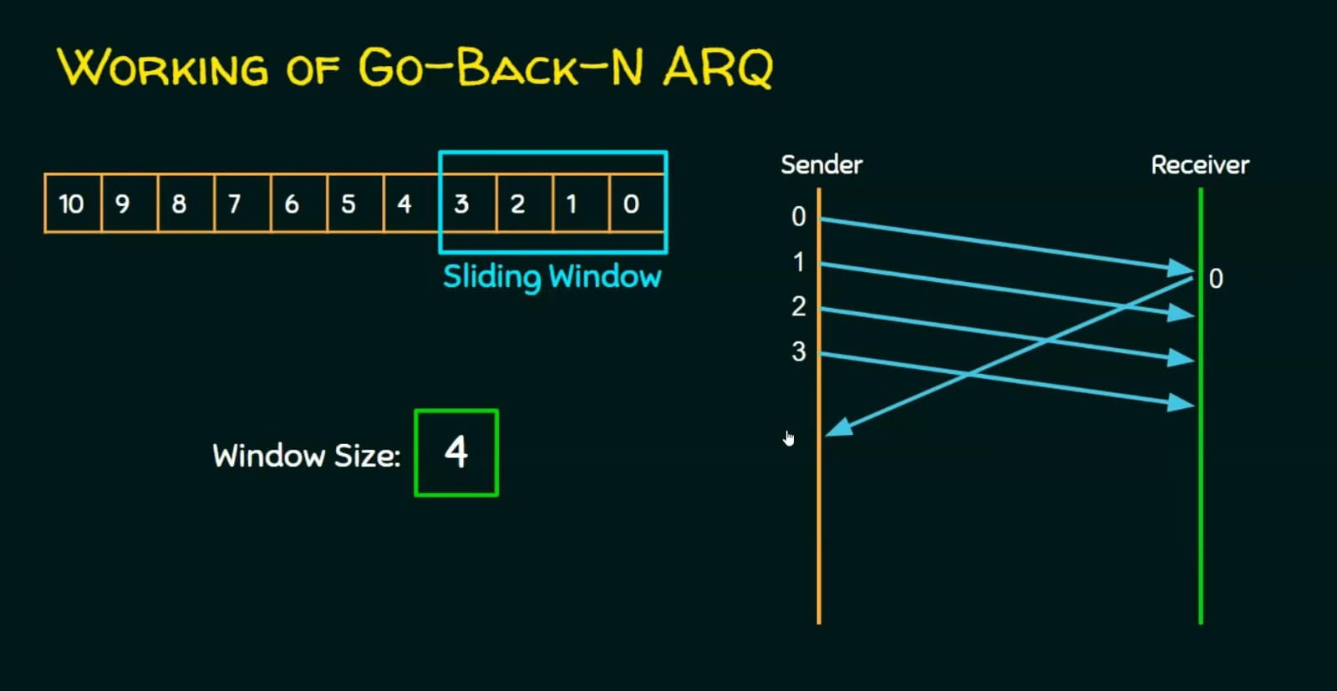

Slide 101
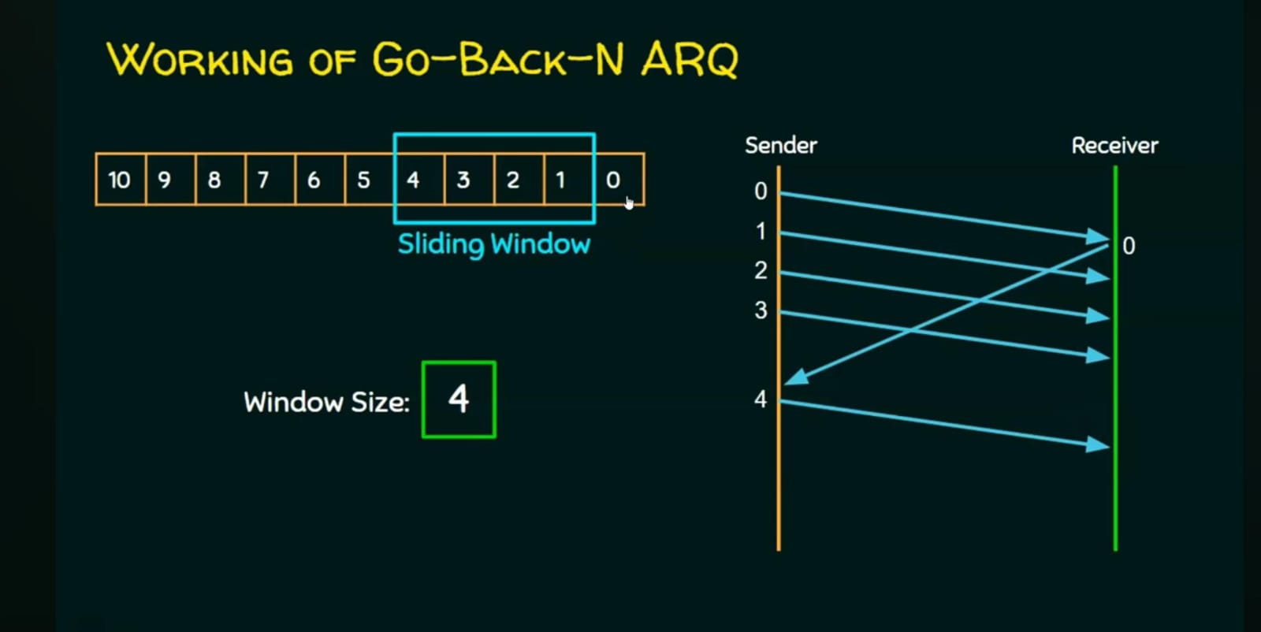

Slide 102
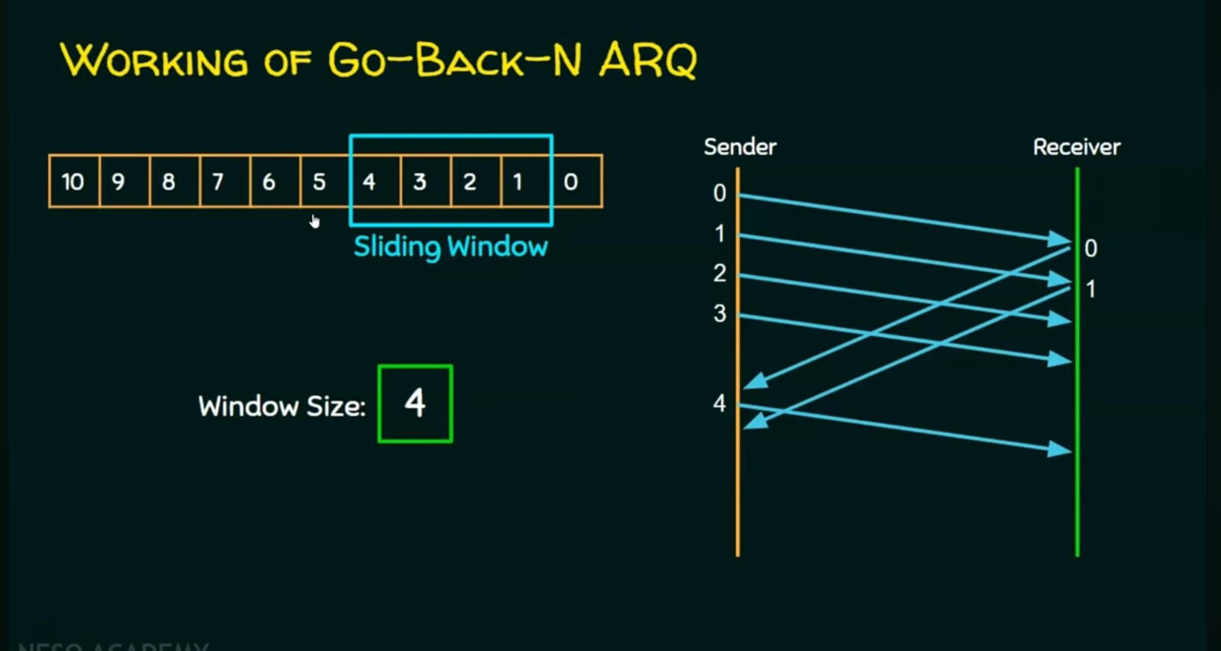

Slide 103
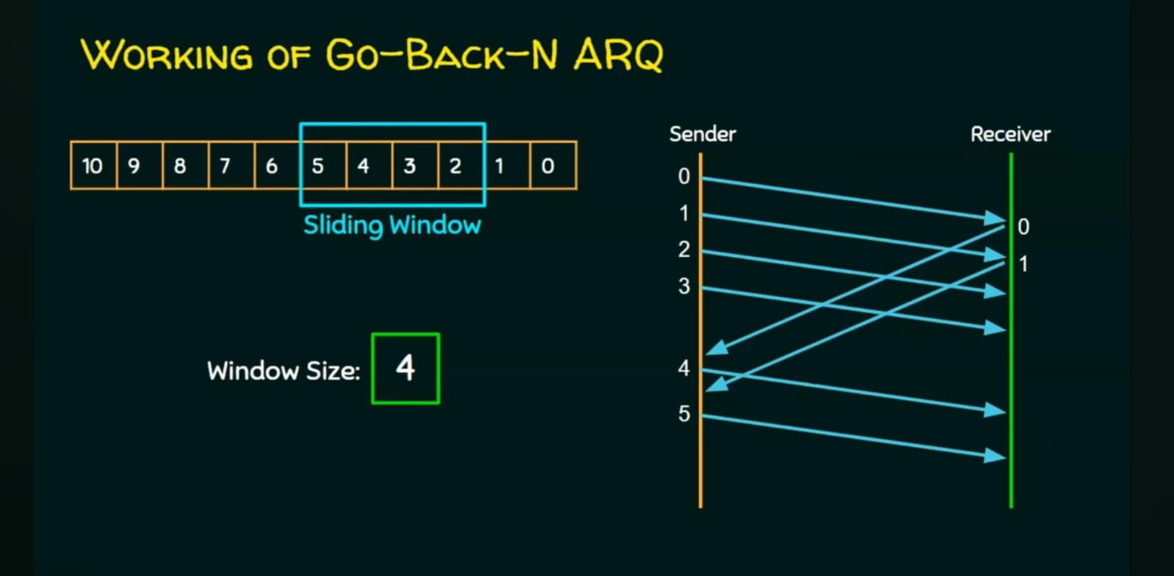

Slide 104


Slide 105


Slide 106


Slide 107


Slide 108


Slide 109


Slide 110


Slide 111


Slide 112


Slide 113

Example Data link protocols

Slide 114
Data link protocols
Synchronous Data Link Protocol (SDLC) − SDLC was developed by IBM in the 1970s as part of Systems Network Architecture.
It is also used to connect all of the remote devices to mainframe computers at central locations may be in point-to-point (one-to-one) or point-to-multipoint (one-to-many) connections.
It is also used to make sure that the data units should arrive correctly and with right flow from one network point to next network point

Slide 115
Data link protocols
High Level Data Link Protocol (HDLC) − HDLC is based upon SDLC and provides both unreliable service and reliable service.
It is a bit – oriented protocol that is applicable for both point – to – point and multipoint communications.
Serial Line Interface Protocol (SLIP) − This is a simple protocol for transmitting data units between an Internet service provider (ISP) and home user over a dial-up link.
It does not provide error detection / correction facilities.

Slide 116
Data link protocols
Point - to - Point Protocol (PPP) − This is used to transmit multiprotocol data between two directly connected (point-to-point) computers.
It is a byte – oriented protocol that is widely used in broadband communications having heavy loads and high speeds.
Link Control Protocol (LCP) − It is one of PPP protocols that is responsible for establishing, configuring, testing, maintaining and terminating links for transmission.
It also imparts negotiation for set up of options and use of features by the two endpoints of the links

Slide 117
Data link protocols
Network Control Protocol (NCP) − These protocols are used for negotiating the parameters and facilities for the network layer.
For every higher-layer protocol supported by PPP, one NCP is there.

Slide 118
POINT –TO-POINT PROTOCOL:
Link Dead:
In this phase the link is not used.
There is no active no carrier in this phase
Link establishment:
If the carrier is detected ppp enter this phase.
In this phase with the help of LCP options are negotiated.
If the negotiation is success, it enters into authentication phase.

Slide 119
POINT –TO-POINT PROTOCOL:
Authenticate:
It is an optional phase After the LCP setup the link, the password authentication protocol (PAP) will authenticate the sender.
If authentication fails, PAP informs the LCP to terminate the link, if successful control goes to next phase.
Network layer protocol:
In this phase Negotiation over network layer protocol occurs with the help of network control protocol (NCP).
Open: In this phase actual transfer of data packets takes place.
Terminate: Once data transfer is completed connection should be terminated.

Slide 120

HDLC (High Level Data Link Control):
HDLC is a bit-oriented protocol for communication over point-to-point and multipoint links.
HDLC FRAME FORMAT:

Slide 121
HDLC (High Level Data Link Control):
HDLC FRAME FORMAT:
Flag: The Flag field of an HDLC frame is and 8-bit sequence with the pattern 01111110, which indicates the beginning and end of the frame.
Address field: It contains the address of the secondary station. If a primary station created the frame, it contains a ‘To address’. If a secondary station created the frame, it contains the ‘From address’.
Control field: It is used for flow and error control.
Information (Data) field: Contains the actual user’s data.
Frame Check Sequence: The frame check sequence number is the HDLC error detection field.

Slide 122
QUIZ 8:
Which protocol does the PPP protocol provide for handling the capabilities of the connection/link on the network? a) LCP b) NCP c) Both LCP and NCP d) TCP Answer: c
PPP provides the _______ layer in the TCP/IP suite. a) Link b) Network c) Transport d) Application Answer: a

Slide 123
QUIZ 8:
A Link Control Protocol (LCP) is used for ____________ a) Establishing, configuring and testing the data-link connection b) Establishing and configuring different network-layer protocols c) Testing the different network-layer protocols d) Provides for multiplexing of different network-layer protocols Answer: a
A family of network control protocols (NCPs) ____________ a) Are a series of independently defined protocols that provide a dynamic b) Are a series of independently-defined protocols that encapsulate c) Are a series of independently defined protocols that provide transparent d) The same as NFS Answer: b

Slide 124
SUMMARY:
Example Data link protocols
POINT –TO-POINT PROTOCOL
HDLC (High Level Data Link Control)
Quiz

Slide 125
LECTURE 9:
RECAP
Example Data link protocols
POINT –TO-POINT PROTOCOL
HDLC (High Level Data Link Control)
Quiz
AGENDA
Mac protocols
Approaches for sharing a transmission medium
Static channelization
Quiz

Slide 126
MAC sub layer:
The protocols used to determine who goes next on a multiaccess channel belong to a sublayer of the data link layer called the MAC (Medium Access Control) sublayer.
The MAC sublayer is especially important in LANs, particularly wireless ones because wireless is naturally a broadcast channel.
the MAC sublayer is the bottom part of the data link layer.

Slide 127
MAC sub layer:
Communication links may be either point-to-point or multi-point (broadcast) links.
When two stations transmit data simultaneously, data signal will interfere or collide with each other.
The role of the medium access control (MAC) protocols is to co-ordinate multiple accesses to the channel so that information from the source reaches destination reliably.

Slide 128


Slide 129


Slide 130


Slide 131


Slide 132


Slide 133


Slide 134


Slide 135


Slide 136


Slide 137


Slide 138


Slide 139


Slide 140


Slide 141


Slide 142


Slide 143


Slide 144


Slide 145


Slide 146


Slide 147


Slide 148


Slide 149


Slide 150


Slide 151


Slide 152


Slide 153


Slide 154


Slide 155


Slide 156


Slide 157


Slide 158


Slide 159


Slide 160


Slide 161


Slide 162


Slide 163


Slide 164


Slide 165


Slide 166


Slide 167


Slide 168



Slide 169


Slide 170


Slide 171



Slide 172


Slide 173


Slide 174


Slide 175



Slide 176



Slide 177


Slide 178
High-level Data Link Control (HDLC)
High-level Data Link Control (HDLC) is a group of communication protocols of the data link layer for transmitting data between network points or nodes.
Since it is a data link protocol, data is organized into frames.
A frame is transmitted via the network to the destination that verifies its successful arrival.
It is a bit - oriented protocol that is applicable for both point - to - point and multipoint communications.
It is reliable for data communication in a networks.

Slide 179
High-level Data Link Control (HDLC)
Transfer Modes
HDLC supports two types of transfer modes, normal response mode and asynchronous balanced mode.
Normal Response Mode (NRM)
Asynchronous Balanced Mode (ABM)

Slide 180
High-level Data Link Control (HDLC)
Transfer Modes
HDLC supports two types of transfer modes, normal response mode and asynchronous balanced mode.
Normal Response Mode (NRM)
Normal Response Mode (NRM) − Here, two types of stations are there, a primary station that send commands and secondary station that can respond to received commands.
It is used for both point - to - point and multipoint communications.

Slide 181


Slide 182

High-level Data Link Control (HDLC)
Transfer Modes
2.Asynchronous Balanced Mode (ABM)
Here, the configuration is balanced, i.e. each station can both send commands and respond to commands.
It is used for only point - to - point communications.

Slide 183
High-level Data Link Control (HDLC)
Banking Networks (ATM)
HDLC provides a secure, reliable link between banking systems for transaction processing.
Example:
ATM machines communicating with central servers, which use HDLC at the data link layer.

Slide 184
Ethernet:
Ethernet is the technology that is commonly used in wired Local area networks(LANs).
A LAN is a network of computers and other electronic devices that covers a small area such as a room, office, or building.
Ethernet is a network protocol that controls how data is transmitted over a LAN and is referred to as the IEEE 802.3 protocol.

Slide 185
How Ethernet Works :
When a machine on the network wants to send data to another, it senses the carrier, which is the main wire connecting the devices.
If it is free, meaning no one is sending anything, it sends the data packet on the network, and the other devices check the packet to see whether they are the recipient.
The recipient consumes the packet.
If there is a packet on the highway, the device that wants to send holds back for some thousandths of a second to try again until it can send.

Slide 186
QUIZ 12:
Ethernet frame consists of ____________ a) MAC address b) IP address c) Default mask d) Network address Answer: a
High speed ethernet works on _________ a) coaxial cable b) twisted pair cable c) optical fiber d) unshielded twisted pair cable Answer: c

Slide 187
Data Link Layer Switching:
What is the main difference among repeater/hub, bridge/switch, and router?
Repeater: physical layer (Layer 1) device, sees 1’s and 0’s, naively forwards what it sees in a port to all other ports
Switch: data link layer (Layer 2) device, sees frames with layer 2 destination address in a port and may forward a frame only to the port toward the Layer 2 destination
Router: network layer (Layer 3) device, sees packets with IP (layer 3) destination addresses, route the packet toward the layer 3 address

Slide 188
Switch:
Data Link layer device
stores and forwards Ethernet frames
examines frame header and selectively forwards frame based on MAC destination address
when frame is to be forwarded on segment, uses CSMA/CD to access segment
transparent
hosts are unaware of presence of switches
plug-and-play, self-learning
switches do not need to be configured

Slide 189

Switch:

Slide 190
Switch:
Self Learning
A switch has a switch table (hash table in the book)
Entry in switch table:
(MAC Address, Interface, Time Stamp)
Stale entries in table dropped (TTL can be 60 min)
Switch learns which hosts can be reached through which interfaces
When a frame is received, switch “learns” location of sender: incoming LAN segment
records sender/location pair in switch table

Slide 191
Switch:
Filtering/Forwarding
When switch receives a frame:
index switch table using MAC dest address
if entry found for destination then {
if dest on segment from which frame arrived then
drop the frame
else forward the frame on interface indicated
}
else flood

Slide 192

Switch:
Example

Slide 193

Switch:
Example

Slide 194
Piggybacking:
Piggybacking is a technique used to improve the efficiency of bidirectional protocols.
When a frame is carrying data from A to B, it can also carry control information about frames from B and vice versa.
Both the sender and receiver maintain control variable S and R.
The sender sends Frame0 and ACK0 appended along with it.
Similarly the receiver sends Frame0 with ACK1 appended to it.
This way both Frame and Acknowledgement will concurrently increase optimal efficiency of bandwidth utilization.

Slide 195

Piggybacking:

Slide 196
QUIZ 7:
The technique of temporarily delaying outgoing acknowledgements so that they can be hooked onto the next outgoing data frame is called ____________ a) piggybacking b) cyclic redundancy check c) fletcher’s checksum d) parity check Answer: a

